Slide 1
Remote COMPUTING
WhyNHow
Nov 12, 2020
Sam Schoerning
help@nmr.mgh.harvard.edu Martinos Center, MGH

Slide 2
Objectives
Forwarding your office phone calls or using Jabber
Receiving text alerts for important emails
File availability & replication with DropBox
Opening Partners applications from home
Using VPN to circumvent the Partners firewall
Connecting to a Martinos Center Mac, PC, linux workstation from home (GoToMyPC, ssh, mosh, screen, VNC)

Slide 3
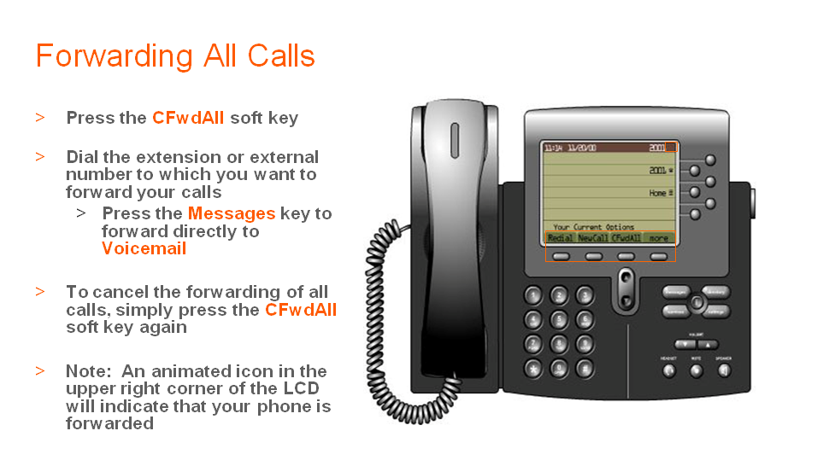
Not 100% stealth
Must be setup beforehand*
Must be turned off manually
Source: https://partnershealthcare.service-now.com/nav_to.do?uri=%2Fkb_view_customer.do%3Fsysparm_article%3DKB0014361

Slide 4
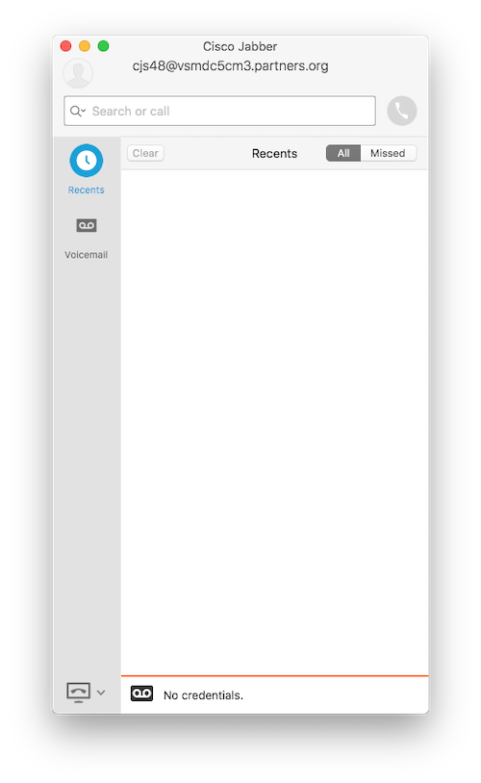
JABBER
Make calls on your home computer/laptop/phone using your Partners telephone line.
You must have an existing extension.
You must request access from the MGB Help Desk.
Reference: https://rc.partners.org/kb/article/3818

Slide 5
TEXT MESSAGE ALERTS FOR EMAIL
https://www.cnet.com/how-to/auto-forward-important-email-to-your-phone-as-a-text-message/

Slide 6
Dropbox
Call 617-726-5085 to request a DropBox for Business account. More info here:
https://rc.partners.org/kb/article/2285
Support issues for DropBox:
617-726-5085

Slide 7
https://workspace.partners.org
Partners Applications are available to users via Mac, Windows or Mobile device via the Partners Workspace at https://workspace.partners.org from either in-hospital, or remotely via VPN.
Citrix Receiver software must be installed on your computer or mobile device: http://receiver.citrix.com
You must have permissons to access applications on the Citrix platform. Please contact your local Keygiver to gain access.
Ref: https://rc.partners.org/it-services/remote-access

Slide 8
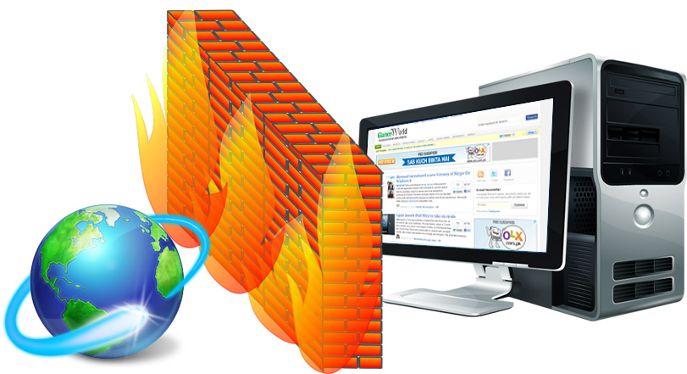
The Partners Firewall
Image source: http://supersonicit.com.au/

Slide 9
VPN
Connect to VPN:
https://it.martinos.org/vpn/
Help with VPN issues:
617-726-5085

Slide 10
GoToMypc
For connecting to your Mac or Windows PC https://rc.partners.org/it-services/remote-access

Slide 11
ssh clients
Windows
https://the.earth.li/~sgtatham/putty/latest/x86/putty.exe Mac
Applications > Utilities > Terminal

Slide 12
DEMO SSH TO WORKSTATION
DEMO RSYNC
DEMO SCREEN

Slide 13
Unix ’screen’ tutorial:
https://www.howtoforge.com/linux_screen

Slide 14
Remote virtual Graphics in Linux
https://it.martinos.org/

Slide 15
virtualgl
Email help@nmr.mgh.harvard.edu to have virtualgl installed on your linux computer
Run graphical programs as follows:
/usr/pubsw/bin/vglrun freeview
/usr/pubsw/bin/vglrun matlab -nosoftwareopengl

Slide 16
Good luck!

