Slide 1
Remote COMPUTING
WhyNHow
Nov 17, 2016
Sam Mehl
help@nmr.mgh.harvard.edu Martinos Center, MGH

Slide 2
Objectives
Forwarding your office phone calls
Receiving text alerts for important emails
File availability with Syncplicity and DropBox
Opening Partners applications from home
Using VPN & SSH tunnels to circumvent the Partners firewall
Connecting to a Martinos Center Mac, PC, linux workstation from home GoToMyPC, ssh, mosh, screen,NoMachine

Slide 3
A note about the sneakernet.

Slide 4
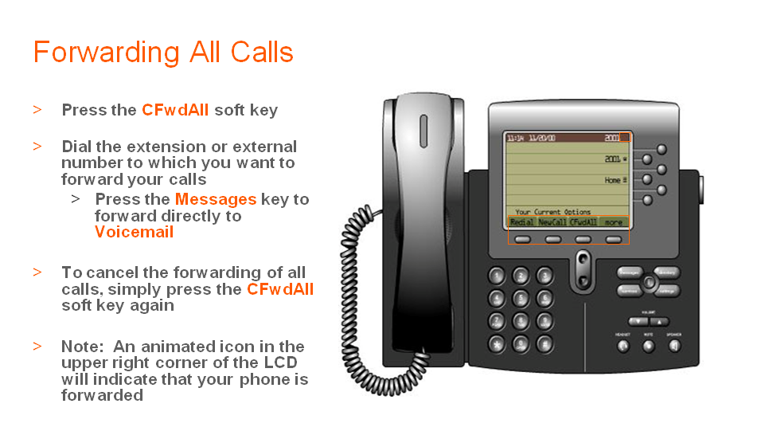
Not 100% stealth
Must be setup beforehand*
Must be turned off manually
Source: https://partnershealthcare.service-now.com/nav_to.do?uri=%2Fkb_view_customer.do%3Fsysparm_article%3DKB0014361

Slide 5
TEXT MESSAGE ALERTS FOR EMAIL
https://www.cnet.com/how-to/auto-forward-important-email-to-your-phone-as-a-text-message/

Slide 6
Syncplicity & Dropbox
How to order Syncplicity (does not work in Linux):
https://rc.partners.org/kb/article/2268
Call 617-726-5085 to request a DropBox Business account. More info here:
https://rc.partners.org/kb/article/2285
Support issues for Syncplicity and DropBox:
617-726-5085

Slide 7
https://workspace.partners.org
Partners Applications are available to users via Mac, Windows or Mobile device via the Partners Workspace available at https://workspace.partners.org from either in-hospital, or remotely (Partners Username and Password required).
Citrix Receiver software must be installed on your computer or mobile device, the software available at: http://receiver.citrix.com
You must have permissons to access applications on the Citirx platform. Please contact your local Keygiver to assign access.
Ref: https://rc.partners.org/it-services/remote-access

Slide 8
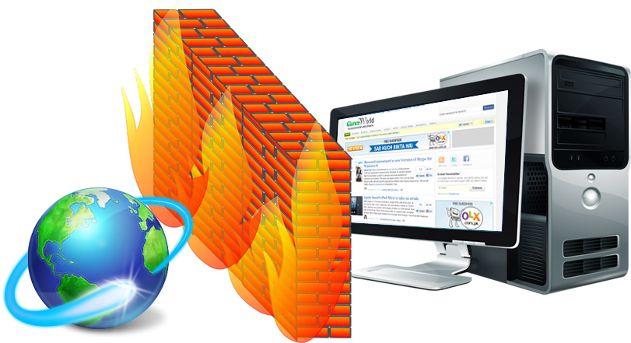
The Partners Firewall
Image source: http://supersonicit.com.au/

Slide 9
VPN
Apply for VPN access:
https://vpnrequests.partners.org
Connect to VPN:
http://www.partners.org/vpn
Help with VPN issues:
617-726-5085

Slide 10
GoToMypc
For connecting to your Mac or Windows PC https://rc.partners.org/it-services/remote-access

Slide 11
SSH
Martinos Center ssh gateway servers:
gate.nmr.mgh.harvard.edu
entry.nmr.mgh.harvard.edu
door.nmr.mgh.harvard.edu
Partners ssh gateway server:
ssh.research.partners.org (request access: https://rc.partners.org/it-services/remote-access)

Slide 12
ssh clients
Windows
https://the.earth.li/~sgtatham/putty/latest/x86/putty.exe Mac
Applications > Utilities > Terminal

Slide 13
DEMO SSH TO WORKSTATION VIA GATEWAYS
DEMO RSYNC
DEMO SCREEN
DEMO MOSH

Slide 14
Download MOSH client for Mac:
http://mosh.mit.edu
Unix ’screen’ tutorial:
https://www.howtoforge.com/linux_screen

Slide 15
CONNECTING remotely TO YOUR LINUX console DESKTOP
Must be enabled ahead of time:
https://www.nmr.mgh.harvard.edu/intranet/computer/remoteAccess/vino
Download RealVNC viewer:
https://www.realvnc.com/download/viewer/

Slide 16
Remote virtual Graphics in Linux
https://www.nmr.mgh.harvard.edu/intranet/computer/remote-access/nomachine
X2Go, OpenNX, VNC are no longer supported

Slide 17
Good luck!

