Slide 1
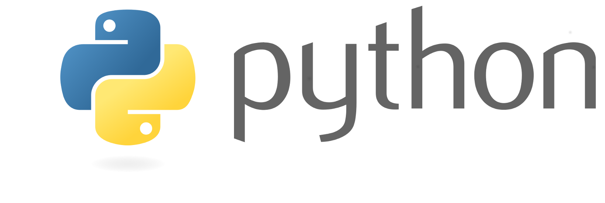
Introduction to Python
Why’N’How 3/19/2020
Jay Patel

Slide 2
Outline
What is python?
Why use python?
How to use python?
IDE
Basic types
Containers
Basic control flow
Scientific Python
Questions?

Slide 3
Outline
What is python?
Why use python?
How to use python?
IDE
Basic types
Containers
Basic control flow
Scientific Python
Questions?

Slide 4
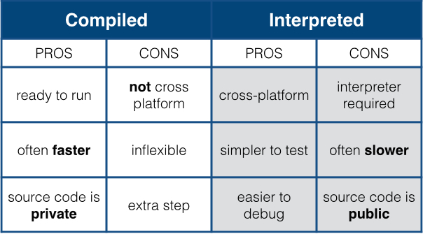
What is Python?
Interpreted (i.e. non-compiled), high-level programming language
Compiler translates to source code to machine code before executing script
Interpreter executes source code directly without prior compilation
Open-source (free) and community driven

Slide 5
Outline
What is python?
Why use python?
How to use python?
IDE
Basic types
Containers
Basic control flow
Scientific Python
Questions?

Slide 6
Why use Python?
PROs:
Designed to be intuitive and easy to program in (without sacrificing power)
Open source, with a large community of packages and resources
One of the most commonly used programming languages in the world
“Tried and True” language that has been in development for decades
High quality visualizations
Runs on most operating systems and platforms
CONs:
Slower than “pure” (i.e. compiled) languages like C++
Smaller/specialized packages might not be well tested / maintained

Slide 7
Outline
What is python?
Why use python?
How to use python?
IDE
Basic types
Containers
Basic control flow
Scientific Python
Questions?

Slide 8
How to use Python
Install python 3 distribution for your system
Note: Python 2.7 is no longer maintained and you should do your best to transition all old code to python 3!
Install useful dependencies
pip install numpy, matplotlib, scipy, nibabel, pandas, sklearn, …
Download an IDE of your choice
Visual Studio Code
https://stackoverflow.com/questions/81584/what-ide-to-use-for-python
Or run interactively in a Jupyter notebook

Slide 9
IDE

Slide 10
Outline
What is python?
Why use python?
How to use python?
IDE
Basic types
Containers
Basic control flow
Scientific Python
Questions?

Slide 11
Types Basic Operations
Numbers
Integer
Float
Complex
Boolean
String
Operators (non-exhaustive list)
+ #addition
- #subtraction
* #multiplication
** # power
% # modulus
“in” # check if element is in container
Functions
(Custom) operations that take one or more pieces of data as arguments
len(‘world’)
Methods
Functions called directly off data using the “.” operator
‘Hello World”.split()

Slide 12
Examples: Numerical types

Slide 13
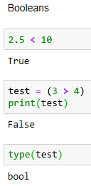
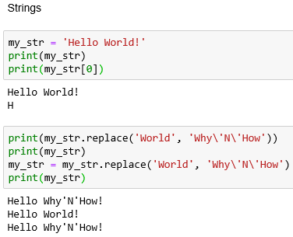
Examples: Booleans and Strings

Slide 14
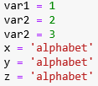
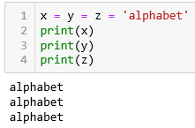
Variable Assignment

Slide 15
Outline
What is python?
Why use python?
How to use python?
IDE
Basic types
Containers
Basic control flow
Scientific Python
Questions?

Slide 16
Data Containers (aka Objects)
Lists (mutable set of objects)
var = ['one', 1, 1.0]
Tuples (immutable set of objects)
var = ('one', 1, 1.0)
Dictionaries (hashing arbitrary key names to values)
var = {'one': 1, 'two': 2, 1: 'one', 2: 'two’}
Etc.
Each of the above has its own set of methods

Slide 17
When to use one container over another
Lists
If you need to append/insert/remove data from a collection of (arbitrary typed) data
Tuples
If you are defining a constant set of values (and then not change it), iterating over a tuple is faster than iterating over a list
Dictionaries
If you need a key:value pairing structure for your dataset (i.e. searching for a persons name (a key) will provide their phone number (a value))

Slide 18
Indexing through Containers

Slide 19
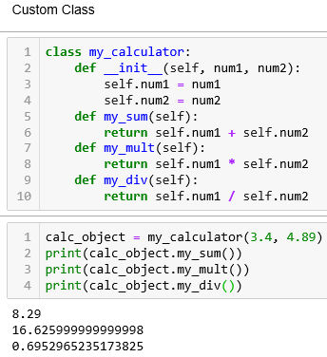
Scripting vs Functions vs Object Oriented Approach

Slide 20
Outline
What is python?
Why use python?
How to use python?
IDE
Basic types
Containers
Basic control flow
Scientific Python
Questions?

Slide 21
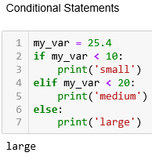
Basic Control Flow: Conditional Statements
Use if-elif-else statements to perform certain actions only if they meet the specified condition

Slide 22
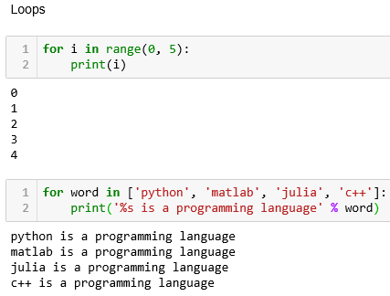
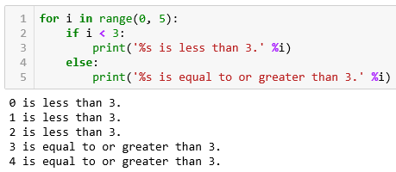
Basic Control Flow: Loops
Use to iterate over a container

Slide 23
List Comprehension
Pythonic way to compress loops into a single line
Slight speed gain to using list comprehension
Normal loop syntax:
For item in list: if conditional: expression
List comprehension syntax:
[expression for item in list if conditional]

Slide 24
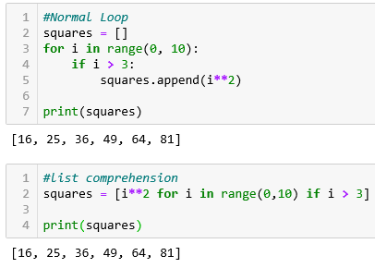
List Comprehension

Slide 25
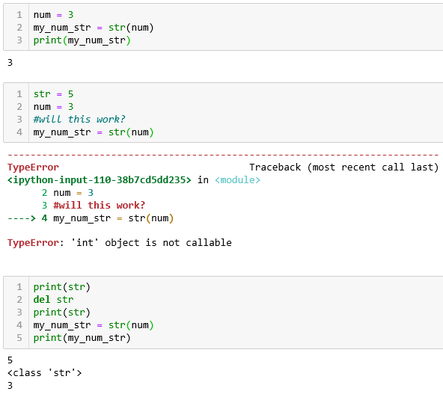
Variable Naming Conventions
Very important to name your variables properly
Helps others read your code (and helps you read your own code too!)
Will help mitigate issues with variable overwriting/overloading

Slide 26
Style Conventions
PEP8 – Style Guide for Python Code
https://www.python.org/dev/peps/pep-0008/
Extremely thorough resource on how to standardize your coding style
Covers:
Proper indentation, variable naming, commenting, documentation, maximum line lengths, imports, etc.

Slide 27
Outline
What is python?
Why use python?
How to use python?
IDE
Basic types
Containers
Basic control flow
Scientific Python
Questions?

Slide 28
Scientific Python
For high efficiency, scientific computation and visualization, need to install external packages
NumPy
Pandas
Matplotlib
SciPy
These packages (among countless others like sympy, scikit-image, scikit-learn, h5py, nibabel, etc.) will enable you to process high dimensional data much more efficiently than possible using base python

Slide 29
NumPy: N-dimensional arrays
Specifically designed for efficient/fast computation
Should be used in lieu of lists/arrays if working with entirely numeric data
Matlab users -> https://docs.scipy.org/doc/numpy/user/numpy-for-matlab-users.html
Extremely comprehensive resource comparing matlab syntax to numpy/scipy

Slide 30
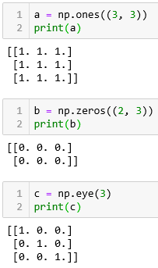
NumPy: creating arrays

Slide 31
NumPy: Copies vs. Views
Views are created by slicing through an array
This does not create a new array in memory
Instead, the same memory address is shared by the original array and new sliced view
Changing data on the view will change the original array!
Use the copy function to copy an array to a completely new location in memory

Slide 32
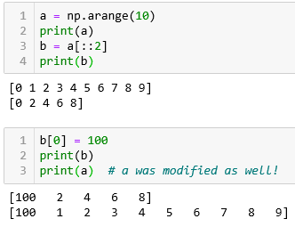
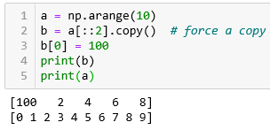
NumPy: Copies vs. Views

Slide 33
NumPy: reductions across specific dimensions
Same applies for most numpy functions
np.mean, np.argmax, np.argmin, np.min, np.max, np.cumsum, np.sort, etc.

Slide 34
Other useful Scientific Python packages
Pandas
Powerful data analysis and manipulation tool
Matplotlib
Matlab style plotting
Scipy
Works with NumPy to offer highly efficient matrix processing functions (i.e. signal processing, morphologic operations, statistics, linear algebra, etc.)
Nibabel
Efficient loading/saving of NifTI format volumes
…

Slide 35
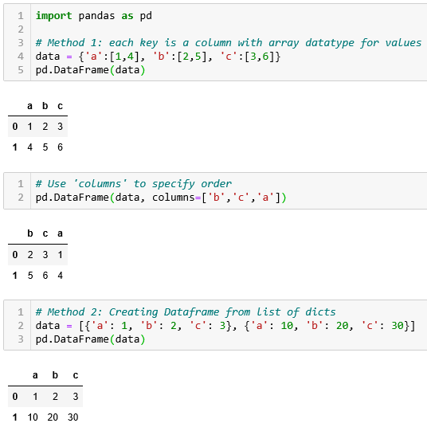
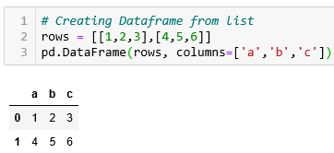
Making Pandas DataFrame

Slide 36
Filtering DataFrame

Slide 37
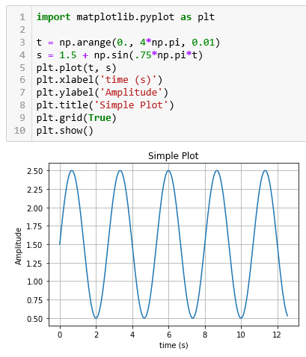
Visualizations in Python
Matplotlib is the standard plotting library and works very similarly to Matlab

Slide 38
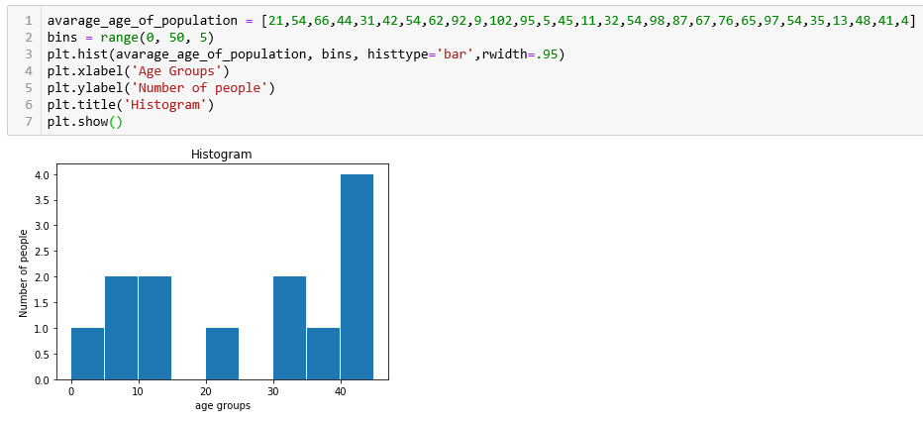
Visualizations in Python

Slide 39
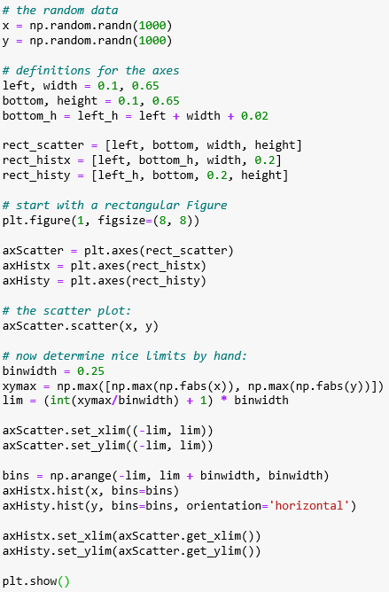
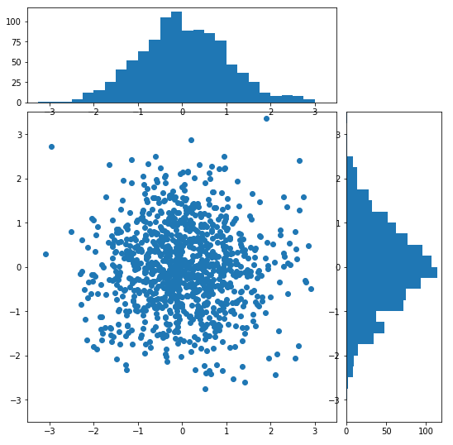
Visualizations in Python

Slide 40
Visualizations in Python: Pandas DataFrame

Slide 41
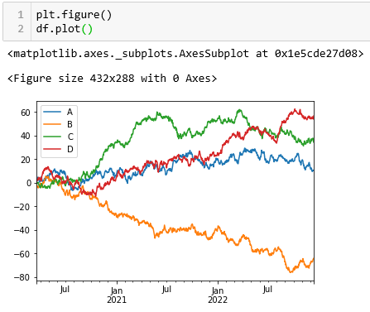
Visualizations in Python: Pandas DataFrame

Slide 42
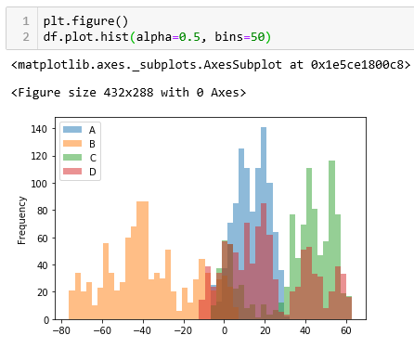
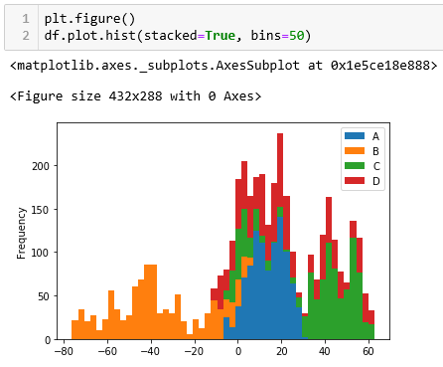
Visualizations in Python: Pandas DataFrame
Normal overlapping histogram
Stacked histogram for easier viewing

Slide 43
NifTI volume processing
NifTI is a very common medical imaging format
NifTI strips away all patient information usually in dicom header making it an excellent format for data processing
NiBabel package to load/save as nifti

Slide 44
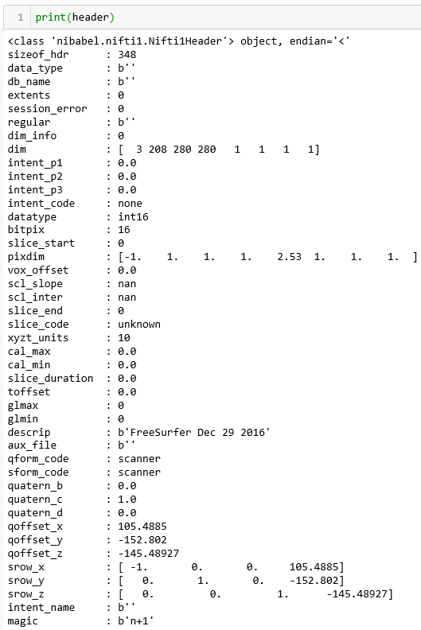
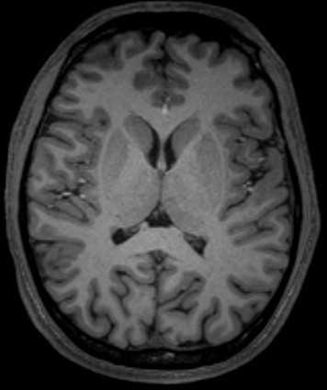
NifTI volume processing

Slide 45
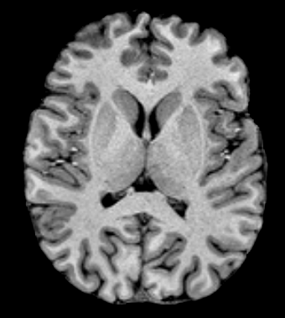
NifTI volume processing

Slide 46
Parallelizing Operations
If processing of patients can be done independently of each other, want to parallelize operation across CPUs to maximize efficiency

Slide 47
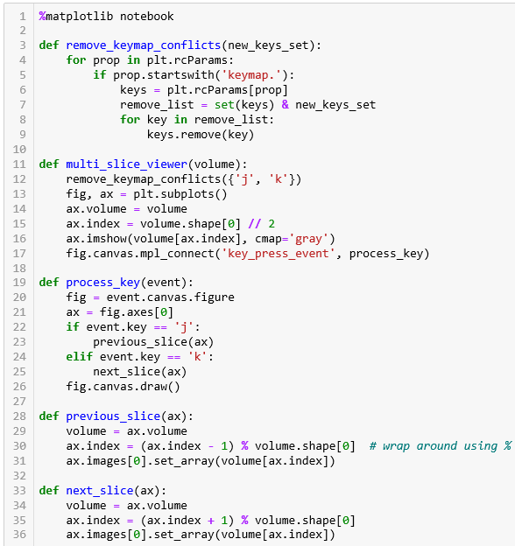
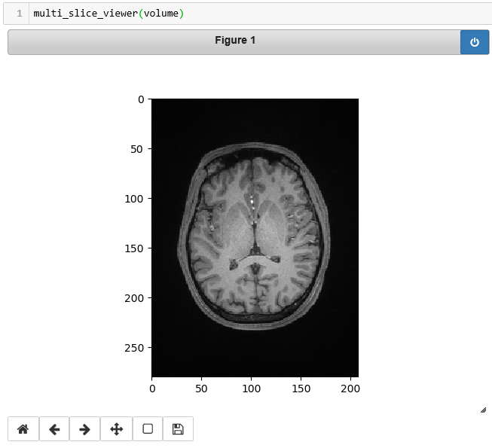
Viewing 3D NumPy arrays in Python
Notes:
This will create a gui that lets your slice through your array. However, much easier to load into an external platform such as Slicer3D

Slide 48
Simple machine learning with scikit-learn
Sklearn contains machine learning implementations
Regressions (linear, logistic)
Classification (Random Forest, SVM)
Dimensionality reduction (PCA)
Clustering (k-means)
Etc.

Slide 50
Linear Regression to predict Diabetes

Slide 51
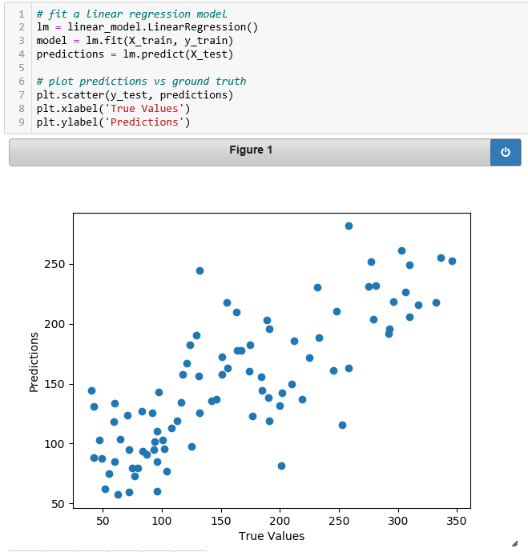
Linear Regression to predict Diabetes

Slide 52
Outline
What is python?
Why use python?
How to use python?
IDE
Basic types
Containers
Basic control flow
Scientific Python
Questions?

Slide 53
Thanks for listening!
Questions?

