Slide 1
Artifacts, ghosts, and phantoms:
An archaeological tour of MR Imaging
Jason Stockmann
Why N How
Oct. 31, 2019

Slide 2
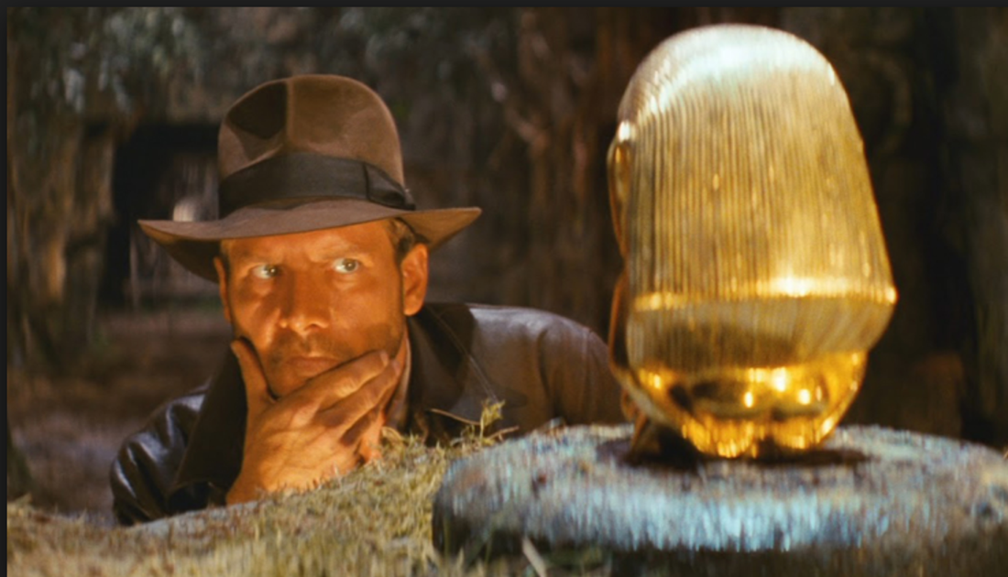
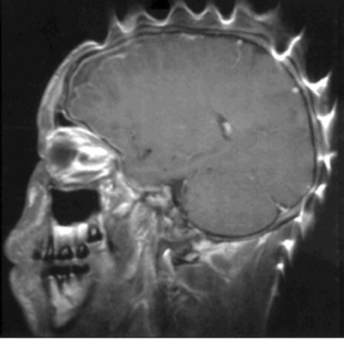
MRI physicist =
Professional artifact hunter
Interesting…
What kind of artifact is this…?
Where does it come from…?
How was it made…?
MRI Physicist

Slide 3
Acknowledgements
Most of the slides borrowed from the lecture notes and presentations of Lawrence Wald, Todd Constable, Jon Polimeni, and Doug Noll

Slide 4
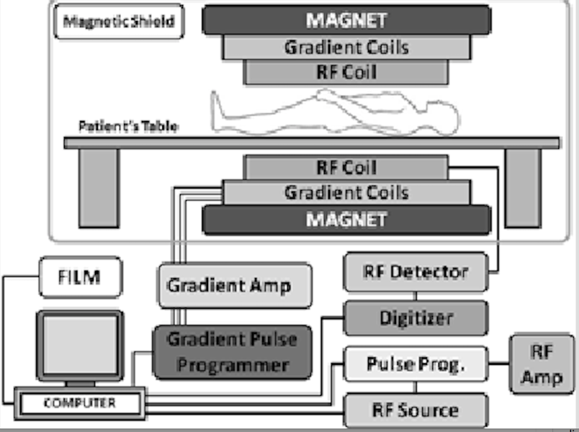
Why does MRI have such a wide variety of image artifacts?
MRI requires seamless integration and interplay of magnet, gradient coil system, RF system, and pulse sequence computer, each of which is a complicated subsystem.
Human body also moves and interacts with RF and B₀ magnetic fields → both static and dynamic (physiological) effects
Very old figure…!

Slide 5
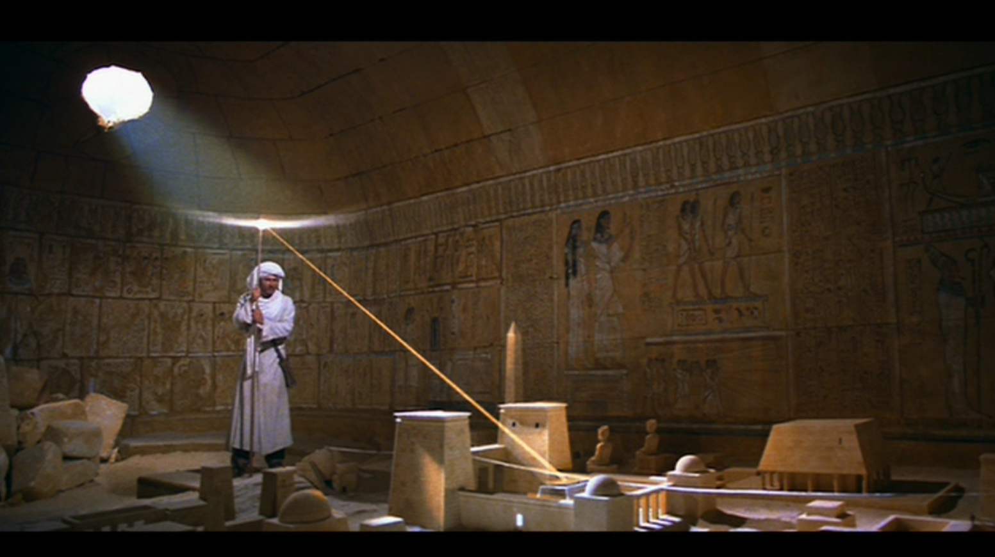
Learn how to pinpoint where the source of your artifact is hidden in the “k-space domain”… You need to know where to look!
K-space city

Slide 6
Understanding artifacts
Data is acquired in k-space domain → 2D or 3D Fourier transform of the image
Learn to think about what’s going wrong with data collection in k-space → use properties of Fourier transform to see what effect these errors will create in image domain

Slide 7
Fourier Transform
Shows you the spatial frequencies that are present in the image (or audio signal, etc.).
Steps:
  (1) Multiply input function (image) by spatial harmonic (sinusoid) with a given frequency
  (2) Integrate over the whole space (1D, 2D, or 3D) → Gives you one point in k-space
  (3) Change spatial frequency (k) and repeat steps (1) and (2) until you have populated all of k-space
One k-space point tells you how much of the corresponding spatial harmonic is needed to build the image. When you add all the harmonics together, the complex-valued functions interfere constructively and destructively in a way that forms the image features.
Jean-Baptiste Joseph Fourier
(1768-1830)
1D Fourier transform along x
M₀ is the object
k_{x} is spatial frequency (k-space coordinate)
In practice we use the discretized version of this formula. Number of k-space points depends on size of image grid
Measured signal is Fourier integral of the projection image!

Slide 8
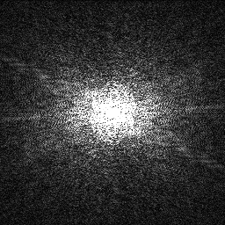
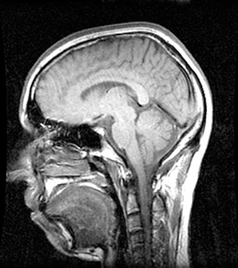
You’ve measured:
intensity at a spatial frequency...
Fourier transform
k_{y}
1 / Δx
k_{x}
FOV_{x} = matrix * Res_{x}
1 / FOV_{x}
Slide courtesy of Lawrence Wald, A. A. Martinos Center, MGH

Slide 9
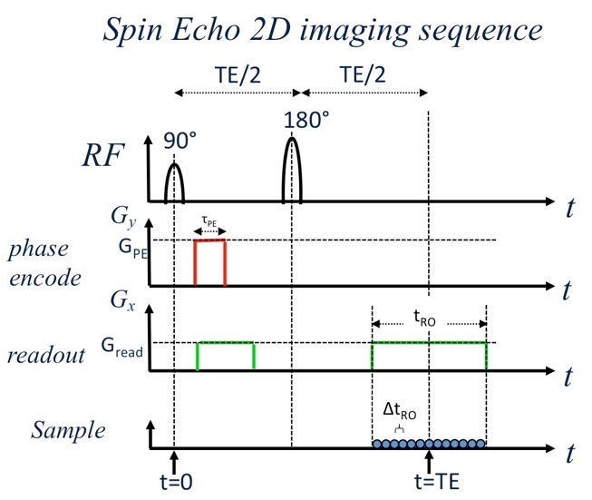
Planning your image…
Figure out what you want
Figure out your kspace params
Figure out your gradient params
k_{y}
1 / Δx
k_{x}
FOV_{x} = matrix * Res_{x}
1 / FOV_{x}
Slide courtesy of Lawrence Wald, A. A. Martinos Center, MGH

Slide 10

Planning your image…
Brains?
Data lands in integer indexed matrix
Ta Da!
k_{y}
N_{x}
N_{x}
Matlab fft2
(Unitary, reversible operator)
N_{y}
N_{y}
k_{x}
Slide courtesy of Lawrence Wald, A. A. Martinos Center, MGH

Slide 11
Gradient: Basics of image encoding
Bo Gx x Bo + Gx x
z
x
Field from gradient coils
Total field
Uniform magnet
Slide courtesy of Lawrence Wald, A. A. Martinos Center, MGH

Slide 12
Recasting the signal equation
Science/engineering principle #1: cast your problem into the form of a problem with a known solution…
Change variables:
Measured signal is Fourier integral of the projection image!
Slide courtesy of Lawrence Wald, A. A. Martinos Center, MGH

Slide 13
One shot per readout line…
TE
k_{y}
RF
G_{z}
G_{x}
k_{x}
G_{y}
Sample
Slide courtesy of Lawrence Wald, A. A. Martinos Center, MGH

Slide 14
Image encoding strategies:
Echo Planar Imaging
All lines in one shot…
k_{y}
RF
G_{z}
esp
G_{x}
k_{x}
G_{y}
Sample
Slide courtesy of Lawrence Wald, A. A. Martinos Center, MGH

Slide 15
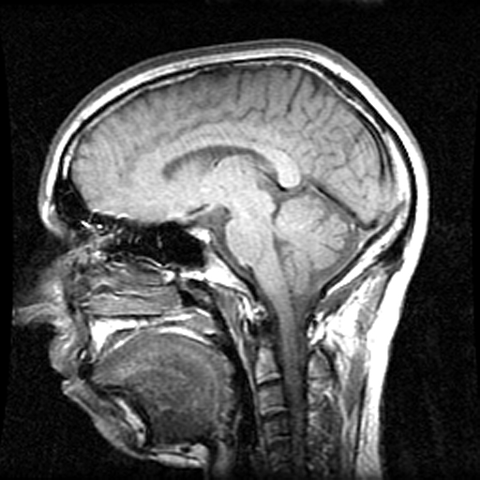
Top 5 features of Fourier transform
1) Information content is equal in the two domains.
  (inverse FT recovers the periodic function)
F(k_{x},k_{y})
f(x,y)
FT⁻¹
256 x 256 complex #s
256 x 256 complex #s
Slide courtesy of Lawrence Wald, A. A. Martinos Center, MGH

Slide 16
Top 5 features of Fourier transform
1) Information content is equal in the two domains.
  (inverse FT recovers the periodic function)
F(k_{x},k_{y})
f(x,y)
FT⁻¹
FOV_{y}
2k_{x}^{max} =1/Δx
FOV_{x}
256 x 256 complex #s
256 x 256 complex #s
Δk_{x}= 1/FOV_{x}
Δx= pixel size
Slide courtesy of Lawrence Wald, A. A. Martinos Center, MGH

Slide 17
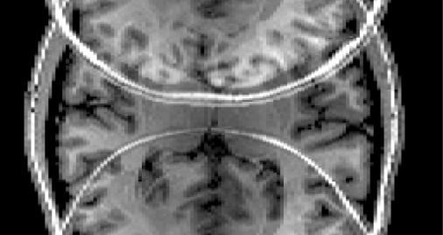
Top 6 features of Fourier transform
  If you make FOV too small (Δk to big), you will get aliasing (image wrap).
k_{y}
FT⁻¹
k_{x}
Only green samples
Slide courtesy of Lawrence Wald, A. A. Martinos Center, MGH

Slide 18
Top 5 features of Fourier transform
2) Even though a real object has 0 phase, phase is incredibly important in k-space.
256 x 256 complex #s
256 x 256 complex #s
Slide courtesy of Lawrence Wald, A. A. Martinos Center, MGH

Slide 19
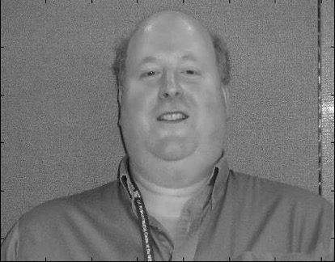
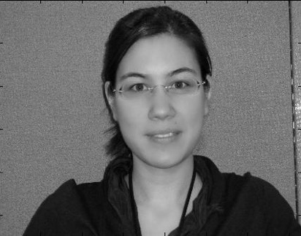
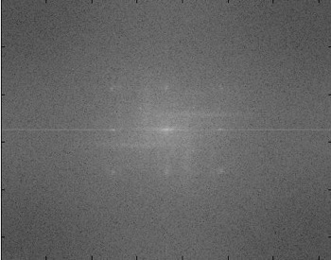
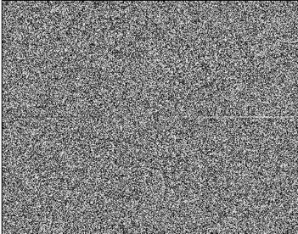
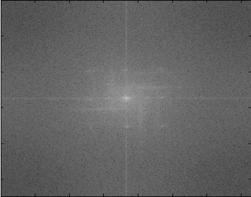
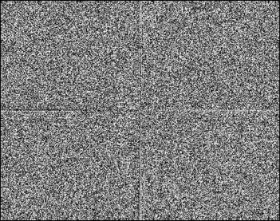
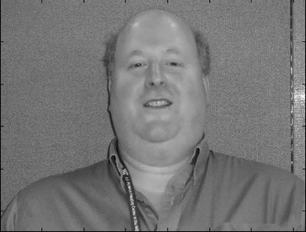

Where is the majority of the information?
magnitude or phase?
Larry
Christin
K-space:
magnitude
phase
magnitude
phase
Slide courtesy of Lawrence Wald, A. A. Martinos Center, MGH

Slide 20
Where is the majority of the information?
magnitude or phase?
Larry
Christin
magnitude
phase
magnitude
phase
??
??
1) Larry (mag. dominate) Christin
2) Christin (phase dominate) Larry
3) Mutant monster (both critical) Mutant monster
Slide courtesy of Lawrence Wald, A. A. Martinos Center, MGH

Slide 21
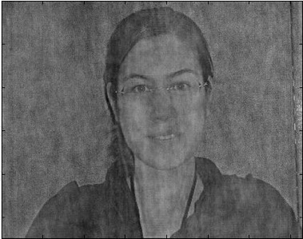
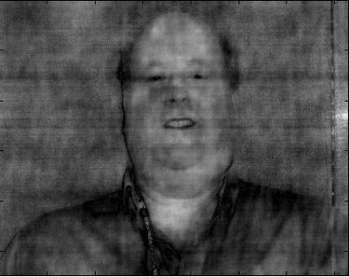
Where is the majority of the information?
magnitude or phase?
Larry
Christin
magnitude
phase
magnitude
phase
Slide courtesy of Lawrence Wald, A. A. Martinos Center, MGH

Slide 22
Top 5 features of Fourier transform
3) Narrow in one domain is wide in the other.
Time/frequency domains
M_{xy}
t
υ
υ_{o}
M_{xy}
t
υ
υ_{o}
Slide courtesy of Lawrence Wald, A. A. Martinos Center, MGH

Slide 23
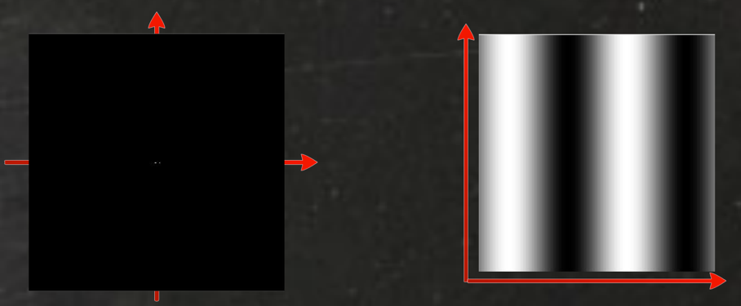
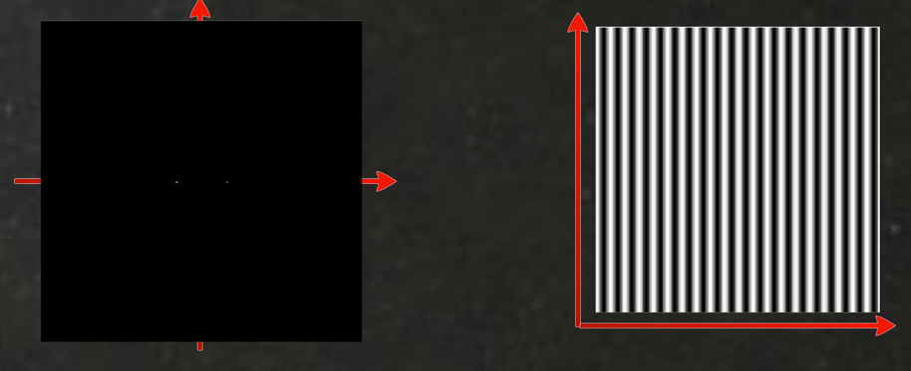
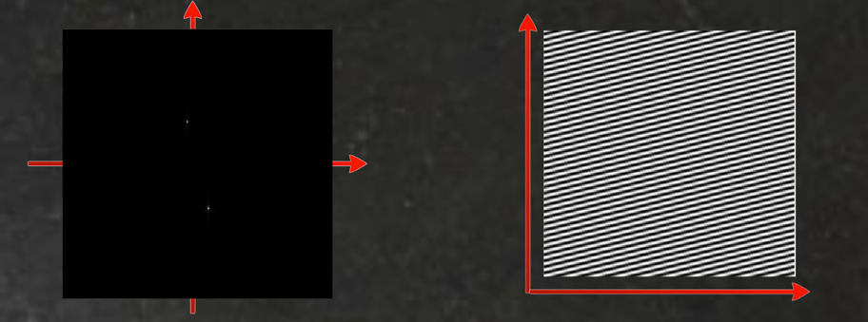
Image domain
K-space
Slide courtesy of Lawrence Wald, A. A. Martinos Center, MGH

Slide 24
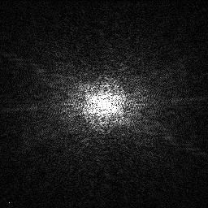
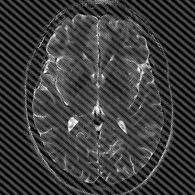
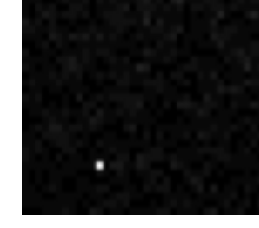
Top 5 features of Fourier transform
3) Narrow in one domain is wide in the other.
Kspace/space domains
One “white pixel” in kspace from a electric spark
Slide courtesy of Lawrence Wald, A. A. Martinos Center, MGH

Slide 25
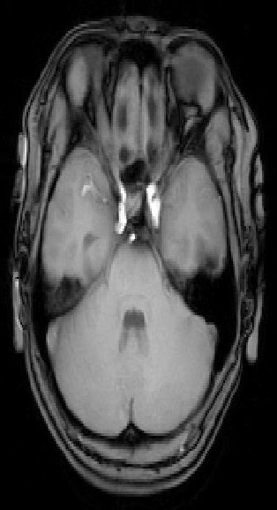
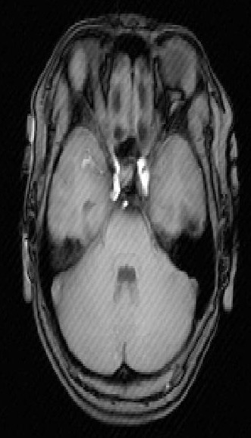
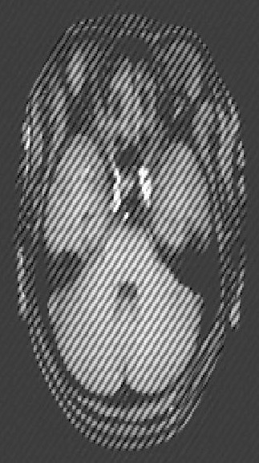
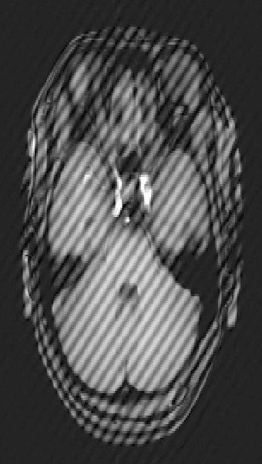
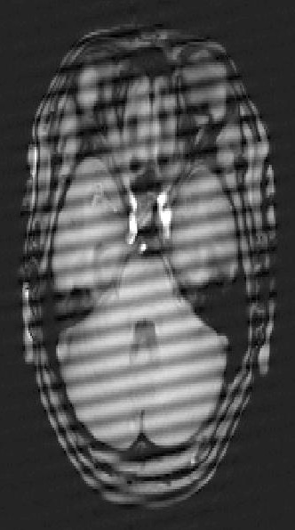
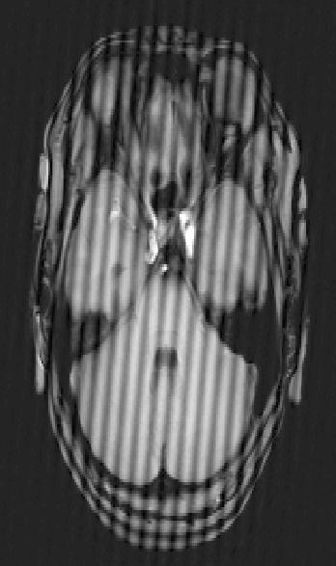
Single Spike in Raw Data: Only Location and Amp of Spike is Changing
Slide courtesy of Todd Constable, Yale Univ.

Slide 26
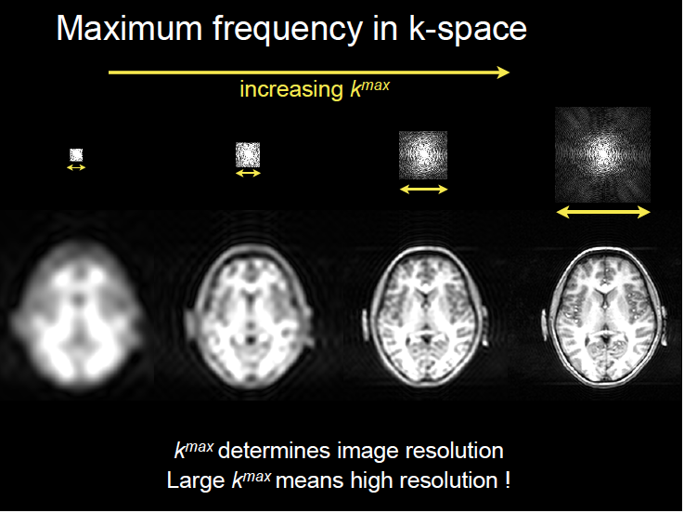
Slide courtesy of Lawrence Wald, A. A. Martinos Center, MGH

Slide 27
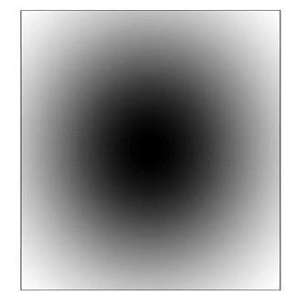
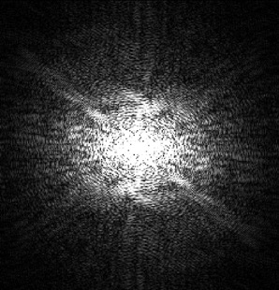
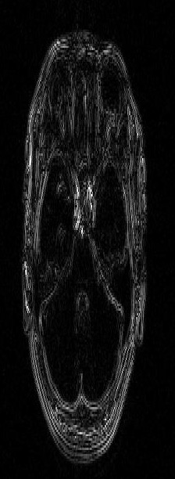
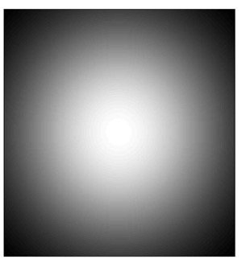
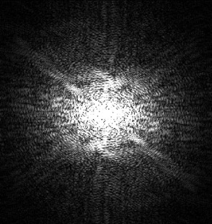
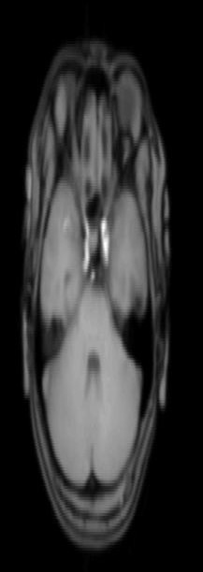
Filtering and k-space
edge enhancement
edge blurring
x =
x =
Slide courtesy of Todd Constable, Yale Univ.

Slide 28
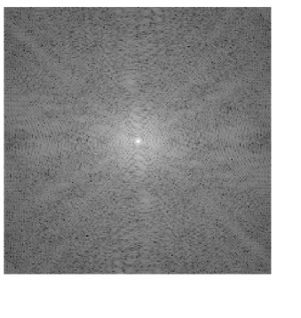
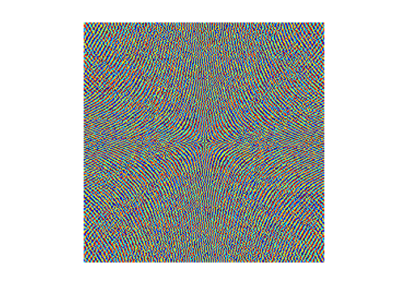
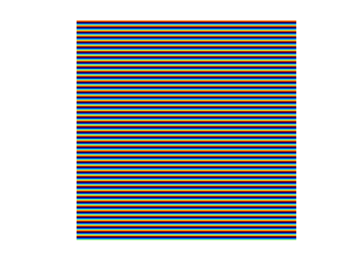
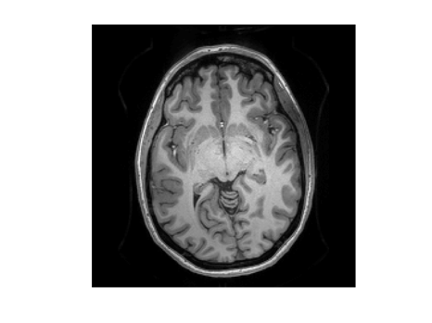
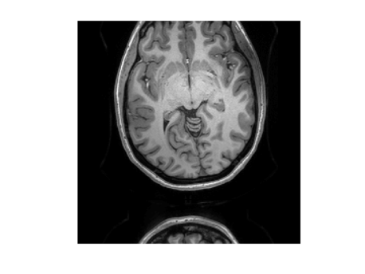
Top 5 features of Fourier transform
4) Shift Theorem
  Translation in space is a linear phase roll in kspace
mag
phase
Let F(k) = FT{ f(x) }
+
FT{ f(x-a) } = F(k) e^{-2πjak}
FT
FT
Adapted from slide provided by Lawrence Wald, A. A. Martinos Center, MGH

Slide 29
Top 5 features of Fourier transform
5) Convolution Theorem
  Multiplication of 2 different kspaces is a FT of a convolution in space
Let: F(k) = FT{ f(x) } R(k) = FT{ r(x) }
Convolution:
FT{ f(x) r(x)} = F(k) R(k)
*
….leads to Gibbs ringing
“FT of a convolution
Is the product of the FTs”
Slide courtesy of Lawrence Wald, A. A. Martinos Center, MGH

Slide 30
Artifacts (a partial list)
Hardware/Acquisition
Human body, physiology, implants
Gradient nonlinearity
Magnet drift
Eddy currents
RF (zipper)
RF interference (zipper)
Truncation
Aliasing
Ghosting
Sequence-specific (streaking in radial trajectories, blurring in spiral)
Susceptibility (rare)
Receiver dynamic range clipping (rare)
Susceptibility: distortion
Susceptibility: dropout/dephasing & implants
RF field inhomogeneity (coil bias)
Motion
Flow
Chemical shift
Subject-specific and generally harder to fix!

Slide 31
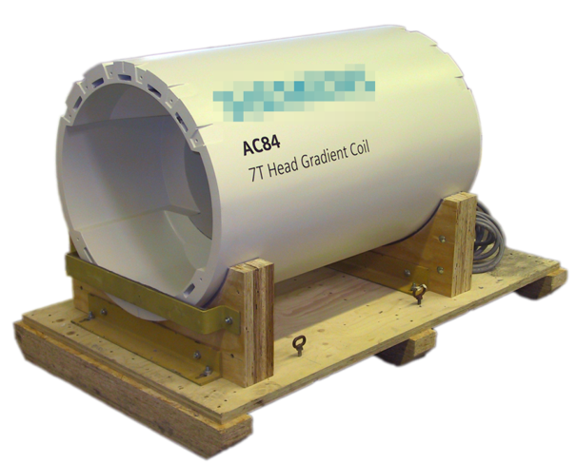
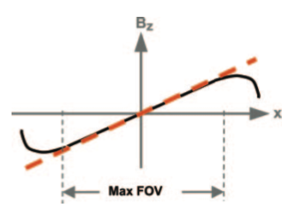
asymmetry in z leads to some gradient nonlinearity
correctable
geometric distortion
intensity bias
spatially nonuniform voxel size
Slide courtesy of Jon Polimeni, MGH

Slide 32
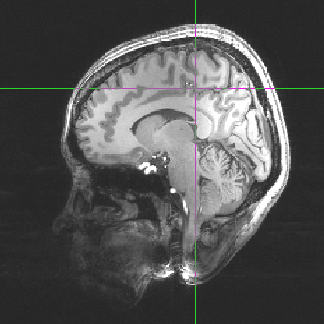
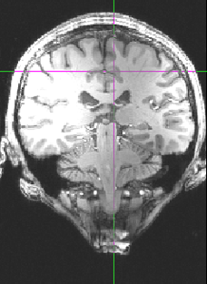
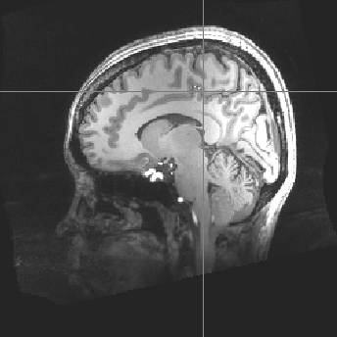
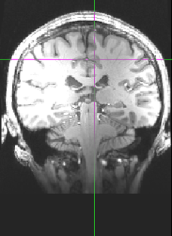
gradient nonlinearity distortion
original, acquired
online correction
distortion is same for any object, pulse sequence—
depends only on gradient coil
Slide courtesy of Jon Polimeni, MGH

Slide 33
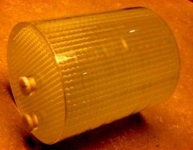
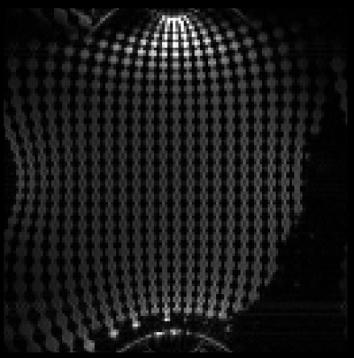


“ball-grid” validation phantom
AC84 head gradient coil
250 mm length × 220 mm dia.
(too large for most RF coils)
water-filled beads, 3 mm dia.
spaced at 10 +/− 0.05 mm
Slide courtesy of Sebastian Littin, Univ. of Freiburg
http://www.birncommunity.org/resources/supplements/brain-morphometry-multi-site-studies/brain-morphometry-mri-phantom/

Slide 34



“ball-grid” validation phantom
AC84 head gradient coil
250 mm length × 220 mm dia.
(too large for most RF coils)
water-filled beads, 3 mm dia.
spaced at 10 +/− 0.05 mm
measuring resulting spacing to validate unwarping
Slide courtesy of Sebastian Littin, Univ. of Freiburg
http://www.birncommunity.org/resources/supplements/brain-morphometry-multi-site-studies/brain-morphometry-mri-phantom/

Slide 35








surface-based grad. nonlin. correction
distorted
corrected
resampling requires interpolation,
blurs image
avoid blurring by deforming surfaces
Slide courtesy of Jon Polimeni, MGH

Slide 36


7T head gradient in-fold artifact
Coil picks up signal from shoulders…
TEM 3
end-capped
27cm dia
14cm long
Shoulder/Brain= 33%, 21%
Body gradients
Head gradients

Slide 37


Zipper Artifacts
RF interference → usually shows up as lines along phase-encode direction
Room not properly shielded
RF source may be in room - electronic devices
Slide courtesy of Todd Constable, Yale Univ.

Slide 38

Truncation Artifacts: Consequence of Convolution rule
Echo signal
Fourier transform (image)
Slide courtesy of Todd Constable, Yale Univ.

Slide 39


Truncation Artifacts (Gibbs ringing)
Truncation artifacts can mimic disease - case of true syringomyelia above left, treated and resolved on the right. Looks like a truncation artifact but in this case is not.
Mayo Clin Proc. 2002;77:291-294 © 2002 Mayo Foundation for Medical Education and Research
Slide courtesy of Todd Constable, Yale Univ.

Slide 40


Eddy currents
Switching magnetic field creates unwanted currents in other nearby conductors in the bore (Lenz’s law)
Resists the desired change in gradient field amplitude

Slide 41

Distortions: Eddy currents
Cause: Fast switching of diffusion-encoding gradients induces eddy currents in conducting components
The shifts are direction-dependent, i.e., different for each DW image
Result: Geometric shifts/distortions
(readout)
(phase encode)
Figure courtesy of Douglas Noll, Univ. Michigan

Slide 42



Aliasing: FOV wrap
K-space samples are too far apart (results in FOV too small)
Image is wrapped around
FOV_{y}=40cm
FOV_{y}=20cm
If resolution is to be maintained between above 2 acquisitions, imaging time will double
In many sequences, you can save time if you skip k-space lines and allow aliasing…
Parallel imaging using multiple RF receive coils “unwraps” aliased image (“iPAT”, “GRAPPA”)
Slide courtesy of Todd Constable, Yale Univ.

Slide 43
Spiking → actively powered components, usually RF coil (PIN diode lines) or gradient coil

Slide 44

Spiking in EPI time series → comes and goes over time
Usually a problem with “active” powered components like gradient coil or RF coil → small arc of electric current generates spike

Slide 45
13th century Welsh medieval manuscript of Arthurian legends under UV light
Adjust brightness and contrast…
On Siemens scanner, click with right mouse button and choose “Select series”
Then click with middle mouse button and drag down and to the left
Then the spikes emerge…

Slide 46


Ghosts!
Bipolar readout gradient → Even and odd lines of k-space are slightly different
Creates image shifted by half a field of view (“N/2 ghost”)
Phase in k-space causes translation of some of the energy in image doman
“Navigators” used to fix ghost
But EPI is very sensitive to hardware instability that can gause ghosting
Le Bihan, JMRI 2006
Figure courtesy of Douglas Noll, Univ. Michigan

Slide 47

Ghost flickering from hardware instability → not the same as “spiking”

Slide 48
Ghost flickering from hardware instability → not the same as “spiking”
Insidious, evil artifact, especially at 7T…. Can bias EPI time series analysis
Possible causes:
RF power amplifier
RF Tx or Rx coil
Too few references lines for training GRAPPA kernel
GRAPPA factor is too high for the coil array → GRAPPA starts to fail
Using a “forbidden” echo spacing → gradient coil acoustic resonance!
Subject motion during ACS lines for GRAPPA

Slide 49
Artifacts
Hardware/Acquisition
Human body, physiology, implants
Gradient nonlinearity
Magnet drift
Eddy currents
RF (zipper)
RF interference (zipper)
Truncation
Aliasing
Ghosting
Sequence-specific (streaking in radial trajectories, blurring in spiral)
Susceptibility (rare)
Receiver dynamic range clipping (rare)
Susceptibility: distortion
Susceptibility: dropout/dephasing & implants
RF field inhomogeneity (coil bias)
Motion
Flow
Chemical shift
Subject-specific and typically harder to fix!!!

Slide 50





Source of in vivo ΔB₀ inhomogeneity
Empty magnet is shimmed very well accurately
Air-tissue interfaces in body perturb B₀ field by up to ~1ppm
  Tissue: diamagnetic
  Air: paramagnetic
Static ΔB₀:
  Sinus and oral cavities
  Ear canals
Dynamic ΔB₀:
  Chest motion in respiration
  Other physiological processes
Source: NIH National Cancer Institute.
http://www.cancer.gov
water
7.00001
7.00000
6.99999
Slide courtesy of Jiazheng Zhou
Air cavities

Slide 51



Static ΔB₀ shimming at UHF
7T ΔB₀ field map shimmed to 2nd order
Susceptibility-contrast (T2*) methods such as blood-oxygen level dependent (BOLD) fMRI and high-res. Susceptibility-weighted imaging (SWI)
Interested in microscopic T2* of tissue
Confounded by macroscopic T2* due to ΔB₀
  grows with B₀
Scanner tries to “shim” out these field perturbations, but only up to 2nd order spatial components can be removed…
200
0
Hz
-200
𝜎_{B0}^{GLOBAL} = 52 Hz
Stockmann JP, NeuroImage, 2017

Slide 52


7T gradient echo mag. and phase images, 300 μm in-plane, cardiac-gated
Images courtesy of Jon Polimeni, MGH

Slide 53



Impact of static ΔB₀ on macroscopic T₂* at 7T
T₂-weighted anatomical reference
+200
ΔB₀ field maps
0
Hz
-200
30
1.5×1.5×2 mm
T₂*
(ms)
T₂* maps
15
1.1 mm iso.
0
Stockmann JP, NeuroImage, 2017

Slide 54





Through-slice dropout in 7T gradient-echo EPI slices
6 mm slice
4 mm
2 mm
1 mm
0.75 mm
Intravoxel dephasing scales with voxel size
Also gets worse with longer TEs
Images courtesy of Jon Polimeni, MGH

Slide 55

Metal implants
Dental metal
Metal in scalp
Severely short T2* near metal in the body
  Dephasing / signal loss in gradient echo
  Warping / distortion
  RF excitation and refocusing pulses don’t work properly
Hip implant
Slide courtesy of Todd Constable, Yale Univ.

Slide 56







Metal Implants
Ferromagnetic Dental Work & a Hair Band, Piercings, Tattoos,
Colored Contact Lens
Spin echo
Gradient echo
Slide courtesy of Todd Constable, Yale Univ.

Slide 57

Geometric distortion in EPI
Depends on B₀ off-resonance frequency and the sequence’s phase encoding bandwidth
Linear phase ramp evolves during echo train (along k-space phase encode direction)
  Causes voxel shift along phase encode direction
Phase encode bandwidth is 1/echo_spacing
So for 1ms echo spacing, and image with 100 pixels in PE direction, 100 Hz off-resonance gives you a 10 pixel shift!
Bigger off-resonance → larger shifts
GRAPPA (R_{y}) reduces distortion! Reduces effective echo spacing
200
0
Hz
-200
Reference: Wald LL, The future of acquisition speed, coverage, sensitivity, and resolution. Neuroimage, 2012.

Slide 58
Reminder!
5) Shift Theorem
  Translation in space is a linear phase roll in kspace
mag
phase
Let F(k) = FT{ f(x) }
+
FT{ f(x-a) } = F(k) e^{-2πjak}
FT
FT
Adapted from slide provided by Lawrence Wald, A. A. Martinos Center, MGH

Slide 59




Less common: Increase gradient strength and slew rate
Geometric distortion in EPI
3T images
7T images
Post-processing unwarping algorithms like TOPUP¹ help, but are not perfect
EPI
EPI
ΔB₀ map
Ref.
A-P
P-A
ΔB₀ map
Ref.
A-P
P-A
Most common mitigation:
parallel imaging² acceleration → reduce effective echo spacing
Hz
Less common: Increase gradient strength and slew rate
¹Andersson JLR, Neuroimage, 2003
²Griswold M, Mag. Res. Med., 2002
= 21.4 Hz
TE=30ms
= 51.9 Hz
TE=23ms
Stockmann JP, NeuroImage, 2017

Slide 60




EPI with alternating slice-encoding gradients: over-easy
7T
1.1 mm iso.
axial acquisition
A→P phase encode
alternating slice-select gradient polarity
“over-easy” EPI
Slide courtesy of Jon Poliemeni
[Błażejewska et al., 2017 ISMRM]

Slide 61

Dynamic ΔB₀ caused by physiology
Ghosting and ringing in structural images
  K-space phase modulation due to B₀ fluctuations → ghosts
  phase stabilization navigators help…
Stability of EPI time-series functional images
  Respiration explains ~65% of variance in phase time-series
Phase_{EPI}(x,y,z,t)
Figure courtesy of Marta Bianciardi, MGH
Regress out in post-processing

Slide 62
Spatiotemporal B₀ fluctuations are worse at 7T, especially in deep brain
Emerging method: Use real-time field monitoring and B₀ shimming to reduce artifacts in structural images
Gross et al., ISMRM 2016
Feedback-controlled dynamic B₀ shim updating could help….

Slide 63












tSNR discontinuity in accel. EPI: chest motion during respiration
free breathing during ACS acquisition
breath-hold during ACS acquisition
conventional
tSNR
conventional
tSNR
conventional
std.
conventional
std.
FLEET (α_{i} = 5°)
tSNR
FLEET (α_{i} = 5°)
tSNR
FLEET prevents phase errors between shots caused by dynamic B₀ changes
Slide courtesy of Jon Polimeni, MGH

Slide 64

effects of motion: conventional ACS
Slide courtesy of
Jon Polimeni, MGH
vulnerability to motion assessed with a mechanical, anthropomorphic head phantom rocking 5°every 15 s

Slide 65

effects of motion: FLEET ACS
Slide courtesy of
Jon Polimeni, MGH
vulnerability to motion assessed with a mechanical, anthropomorphic head phantom rocking 5°every 15 s

Slide 66









Surface Coil B₁⁻ Sensitivity Profile Effects
coil 1 coil 2 image 1 image 2
coil 3 coil 4 image 3 image 4
Combined is brighter where Rx coils are more sensitive
4 surface coils and their sensitivity profiles resultant magnitude images
Slide courtesy of Todd Constable, Yale Univ.

Slide 67


RF B₁⁺ inhomogeneity at ultra-high field (7T)
Interaction of transmit RF field with body tissue (dielectric permittivity and conductivity)
Dark shading in images, loss of contrast
B₁⁺ field amplitude
7T brain images
Ugurbil K, NeuroImage, 2017.

Slide 68


Motion Artifacts
Motion causes to phase errors in the data which leads to mis-registration in the phase encode (y) direction
periodic motion leads to ghosting (shifted images that can constructively or destructively interfere with the primary image)
Remedies:
  correct for motion induced phase errors
  fast imaging to freeze motion
  follow motion
Slide courtesy of Todd Constable, Yale Univ.

Slide 69


1D Example: Motion Present
consider a 1D image consisting of a box
  periodic motion
original
k-space data
Fourier Transform
.
*
Fourier Transform
=
modulation from periodic motion
ghost images
data domain (time/k-space)
image domain
Slide courtesy of Todd Constable, Yale Univ.

Slide 70
1D Example: Motion Present
consider a 1D image consisting of a box
  periodic motion
original
k-space data
FT
.
*
periodic motion
=
modulation of original data by periodic phase errors leads to discrete ghost images
Slide courtesy of Todd Constable, Yale Univ.

Slide 71
1D Example: Motion Present
consider a 1D image consisting of a box
  periodic motion
original
k-space data
FT
.
*
periodic motion
=
ghosts separated in this example
usually overlap in practice
Slide courtesy of Todd Constable, Yale Univ.

Slide 72




Motion Artifacts in 2D:
Conventional Data Acquisition
2DFT
data acquired 1 line at a time with a delay = TR between each line
Slide courtesy of Todd Constable, Yale Univ.

Slide 73





Motion Artifacts in 2D:
Conventional Data Acquisition
2DFT
periodic motion introducing a phase error in the phase encode (vertical) direction results in misplacement of tissue in phase encode direction
Slide courtesy of Todd Constable, Yale Univ.

Slide 74

Motion Artifacts in 2D:
Conventional Data Acquisition
2DFT
phase errors may occur over the datasets for only certain voxels - not all voxels
(e.g. only the moving ones)
Slide courtesy of Todd Constable, Yale Univ.

Slide 75

Motion Artifacts in 2D:
Different severity/extent of artifacts
Motion artifact from flowing blood in vessel
periodic due to pulsatile nature of flow
Motion artifact primarily from beating heart
In this case motion included entire object
Often limited to anterior wall, or specific organs/structures
Slide courtesy of Todd Constable, Yale Univ.

Slide 76


Head motion
No motion
No motion; with MoCo
3D acquisition example:
T1-weighted MPRAGE
With motion; no MoCo
d
With motion; no MoCo
With motion and MoCo

Slide 77

Fat and Water Resonances Move in and out of phase over time
Water precesses approx. 3.5ppm faster than fat
Slide courtesy of Todd Constable, Yale Univ.

Slide 78


Chemical Shift can be Exploited to Produce Fat (left) or Water (right) only Images
Acquisition #1: water and fat inphase
Water image: add acq.#1 + #2
+ =
Water image
Acquisition #2: water and fat out of phase
Fat image: subtract acq.#1-acq#2
- =
Fat image
Called the 2-point Dixon method after the guy who developed it.
Slide courtesy of Todd Constable, Yale Univ.

Slide 79

Fat/Water Chemical Shift Effects
http://mriquestions.com/chemical-shift-artifact.html
Slide courtesy of Todd Constable, Yale Univ.

Slide 80


High readout bandwidth:
No chemical shift artifact
Low readout bandwidth

Slide 81


Fat saturation in EPI
Fat sat ON
Fat sat OFF
Phase encode direction
1.1mm in-plane, 2mm slice
Number of voxels shifted depends on fat-water shift and PE bandwidth (Hz/pix)
3.5 ppm x 300 MHz = 1050 Hz fat-water shift
Echo spacing = 0.81ms with R=4 acceleration → 1/.20ms = 5 KHz for 180 pix → 27 Hz/pix
→ 3.5ppm x 297 MHz/(27 Hz/pix) = 38 pix shift

Slide 82

Physiological noise in EPI time series: Impact on temporal SNR (μ/σ)
9x smaller volume!!!
(two cases agree more closely)
“Noisy tissues” → CSF
Lower noise in white matter
Smaller voxels suffer less partial volume effect from CSF, etc.
References: Triantafyllou C, et al., NeuroImage 2011
Polimeni J and Wald LL, NeuroImage, 2017

Slide 83
Quiz!!!

Slide 84

Quiz
(1) Incomplete fat suppression (chemical shift artifact)
(2) “Zipper” artifact from RF noise contamination
(3) Gibbs ringing from k-space truncation
(4) Head motion artifact
Solution: Can soften with a little filtering/windowing in frequency domain → causes slight blur

Slide 85

Quiz
Spin echo
Gradient echo
(1) Blood flow artifact from hematoma
(2) T2* dephasing from metal object (susceptibility)
(3) RF coil transmit field inhomogeneity
(4) T2* dephasing from sinus cavity air-tissue susceptibility interface
Solution: No easy solution….

Slide 86


Quiz
(1) Blood flow artifact from hematoma
(2) T2* dephasing from metal object (susceptibility)
(3) RF coil transmit field inhomogeneity
(4) T2* dephasing from sinus cavity air-tissue susceptibility interface
200
0
Hz
Solution: Use thinner slices or better B₀ shimming
-200

Slide 87
(1) Geometric stretching from phase encode gradient eddy currents
(2) Motion artifact
(3) Fat-water shift along readout direction
(4) No artifact – image shows real anatomical details

Slide 88

Quiz
(1) Gradient nonlinearity
(2) Geometric distortion from gradient eddy currents
(3) Motion artifact
(4) Geometric distortion due to B₀ offset in body
Solution: Reduce echo spacing time, increase iPAT GRAPPA factor, improve B₀ shimming

Slide 89




Slide 90

McKinstry RC et al., AJR, 2004
Cause: Iron oxide suspended in beeswax hair product

Slide 92

Book recommendations
$35.00 www.lulu.com
(also availible on amazon for 2x this price…)
Very terse, very signal processing oriented. Certainly worth the price.
Wald, 6.S02, 2013 MGH, A.A. Martinos Center

Slide 93

Book recommendations
$151.00 www.amazon.com
Covers everything about different MRI pulse sequences at a nice level…
Wald, 6.S02, 2013 MGH, A.A. Martinos Center

Slide 95

Physiological noise in EPI time series: Impact on temporal SNR (μ/σ)
Fig. 3: Effects of parallel imaging acceleration on the balance between thermal and physiological noise. Example tSNR maps acquired from 3T fMRI data. With higher acceleration factors (R) the √R and g-factor noise penalty causes the acquisition to be thermal-noise dominated, and so the spatial pattern of tSNR is mainly a function of the distance from the surface coils.

Slide 96

k_{y}
180º
k_{x}
Slide courtesy of Lawrence Wald, A. A. Martinos Center, MGH

Slide 97

Top 6 features of Fourier transform
  Because we have pretended our object is periodic, we will get a periodic object… (just keep one of them…)
2)
FT⁻¹
Slide courtesy of Lawrence Wald, A. A. Martinos Center, MGH

Slide 98



Gradient Field Distortions
Produce image distortions
At Martinos, watch out for gradient nonlinearity in the neck in Bay 5 and Bay 8
Usually correctable in software image recon
On MR/PET scanners gradient nonlinearity is a problem in the arms for attenuation correction
Slide courtesy of Todd Constable, Yale Univ.

Slide 99

Field Inhomogeneities: Magnetic Susceptibility Artifacts
Gradient Echo (signal loss & image distortion) Spin echo (image distortion)
Knee joint
Slide courtesy of Todd Constable, Yale Univ.

Slide 100

Respiratory Gating
Slide courtesy of Todd Constable, Yale Univ.

Slide 101


Fat/Water Chemical Shift Effects
dark line can also form if fat and water out of phase
Dark line (gap) as fat shifted down
Bright line where fat shifted to overlap with tissue
Slide courtesy of Todd Constable, Yale Univ.

Slide 102


Body images: fat/water: in- and out- of phase
Fat/water out of phase
Fat/water in phase
Dephasing occurs within a voxel (fat & water in the same voxel)
Slide courtesy of Todd Constable, Yale Univ.

