Slide 1
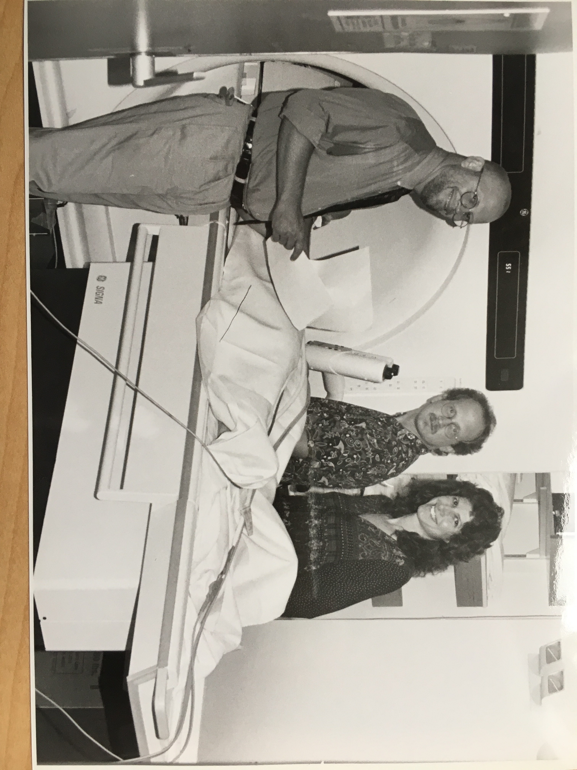
How to Write a Fundable Grant
~1994
Randy L. Gollub, MD PhD
Psychiatrist, Department of Psychiatry MGH
Neuroscientist, Department of Radiology MGH
Professor of Psychiatry, Harvard Medical School
Affiliate Faculty, Health Sciences Technology (HST), MIT
Why N How, 02/27/2020
With thanks to Professor Scott Lukas, PhD, McLean Hospital for materials on content development
and Catherine Mullaly, MD for assistance on updates

Slide 2
Why you should write a grant
Grants fuel research success:
The impact and
Quality of publications
(only secondarily the counted number of papers)
Grants mean money to:
Pay your salary, if you have a “soft money” position
Fund research …
Achieve independence
+/- Obtain/retain space
Advance academic rank
Note:
Only well executed grant applications are funded- all are very competitive
Notes:
Great leaders start with “Why”

Slide 3
Grant Writing 101
How to write a successful grant
Step 1: The Idea
Step 2: Choose a target grant mechanism
Types of grants: HMS, Partners, NIH
Grants processes overview
Getting into the nitty gritty
Timelines
RFA vs PA vs FOA
SROs and POs
Review Process: Study Sections
Forms
Budgets, Costs & Efforts
DISCLAIMER: All information was verified to be current 02/27/2020. But things change so, if you find any errors, broken links, or salient updates, please send them to me and I will update and repost these slides.

Slide 4
Writing a successful grant Step 1: The Idea
Good grant applications:
Address a previously unanswered scientific question, or seek to resolve controversies in a known body of knowledge
Have well developed specific aims, as well as feasible methods & a reasonable hypothesis for each aim
Fundable grants are on target:
The climate of research changes fast
Discuss the project with mentors to determine if it is fundable
Some areas of research receive priority.
Your grant has a greater chance of being funded if it matches the goals of the funding agency
Make sure that there are no restrictions prohibiting your grant.
Ie. During Bush administration, no funding available for stem cell research
Note:
Most grants are not contracts. Your research plan may be modified over time. Sometimes, a new discovery will invalidate your research methods, in which case you may have to come up with a new plan.
If the hypothesis & methods are good, NIH (ie. your Program Officer) may allow modifications to your plan.

Slide 5
Successful Content Strategies
Scope- Less is more. FOCUS.
Over-estimate time & under-estimate work- everything takes longer than expected and reviewers know it. Be realistic.
Amount- Match work to reasonable budget
Salaries typically consume 60-80% of budget; first NIH grants typically $225-250K.
Effort- Diversify your support, but don’t spread yourself too thin; 25-40% effort per project.
Note:
Grant competition is extremely high
No sloppiness in grant preparation will be tolerated (proofread & edit!)

Slide 6
Step 2: Choose the target grant
Who cares about your idea
What resources are required
Can one great idea be strategically partitioned into multiple non-overlapping but highly synergistic grants

Slide 7
Lots of ways to get help with Step 2:
Partners Research Management Intranet:
Gain credentialed access through:
https://mghresearch.partners.org/
Harvard Longwood Campus Research Administration
http://hlcra.harvard.edu
MIT Office of Sponsored Programs
https://ras.mit.edu/

Slide 8
Where you are matters...

Slide 9
MGH by the numbers
https://www.massgeneral.org/research/about/research-institute-by-the-numbers

Slide 10
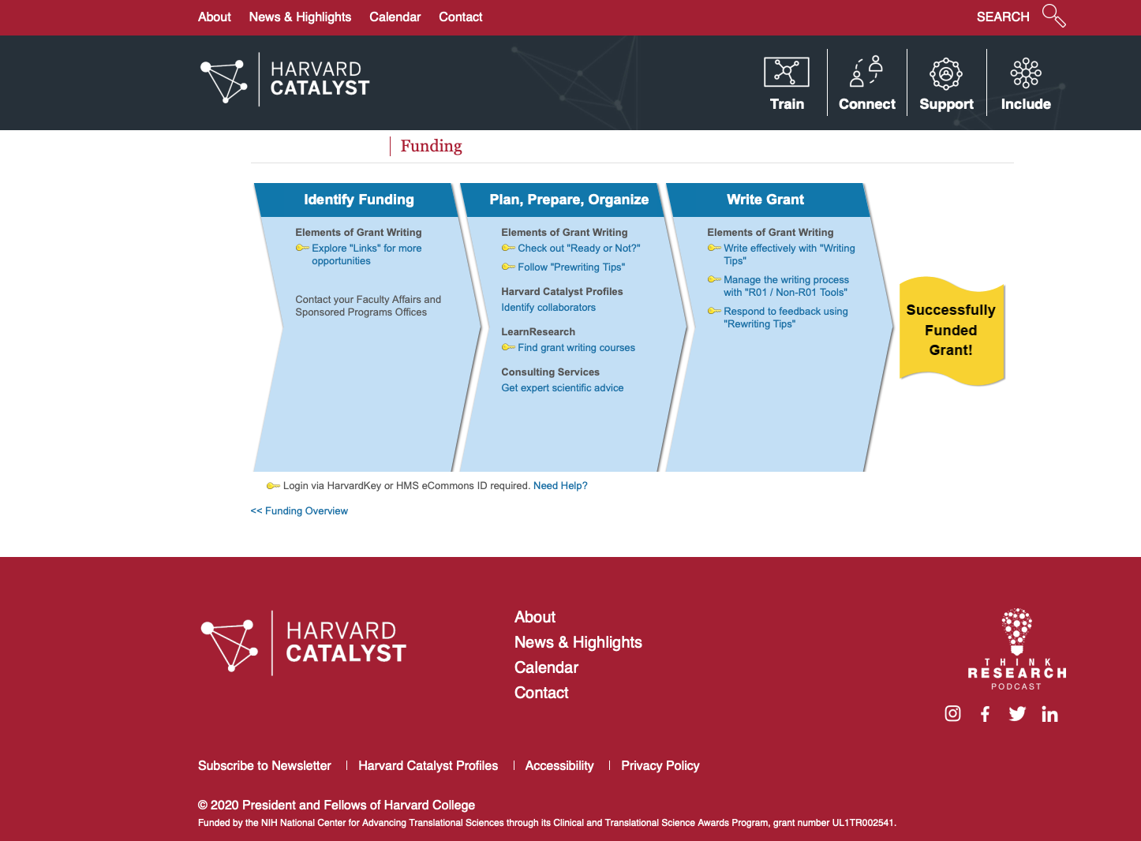
https://catalyst.harvard.edu/fundingdiagram.html
Notes:
This talk on steroids!

Slide 11
https://mghresearch.partners.org/
1
2

Slide 12
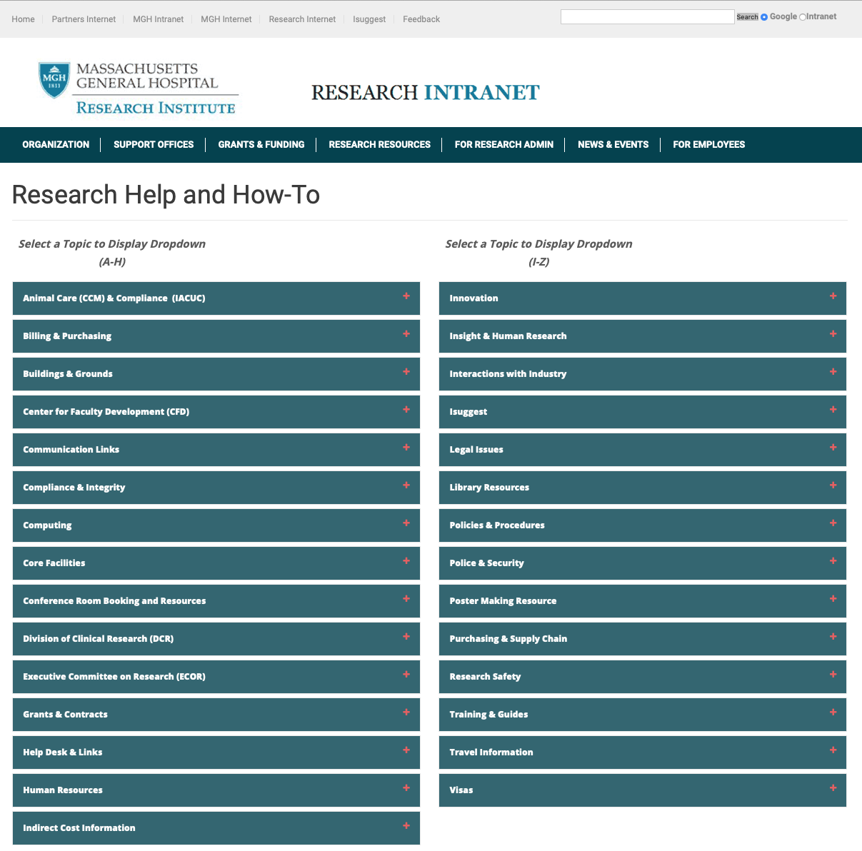
1

Slide 13
2

Slide 14
Avoid Grant Scams!
https://www.hhs.gov/grants/grants/avoid-grant-scams/index.html
There are no easy grants ☺

Slide 15
Types of Grants
Foundation Funds Grants
Detailed guide at HMS website
http://www.hms.harvard.edu/FoundationFunds
Partners/MGH/Harvard institutional Grants
(ie. Harvard Catalyst Pilot Funding, ECOR)
See Harvard Catalyst Grant Central
http://catalyst.harvard.edu/funding.html
NIH Grants
These are the most complex …
But also the most broadly applicable

Slide 16
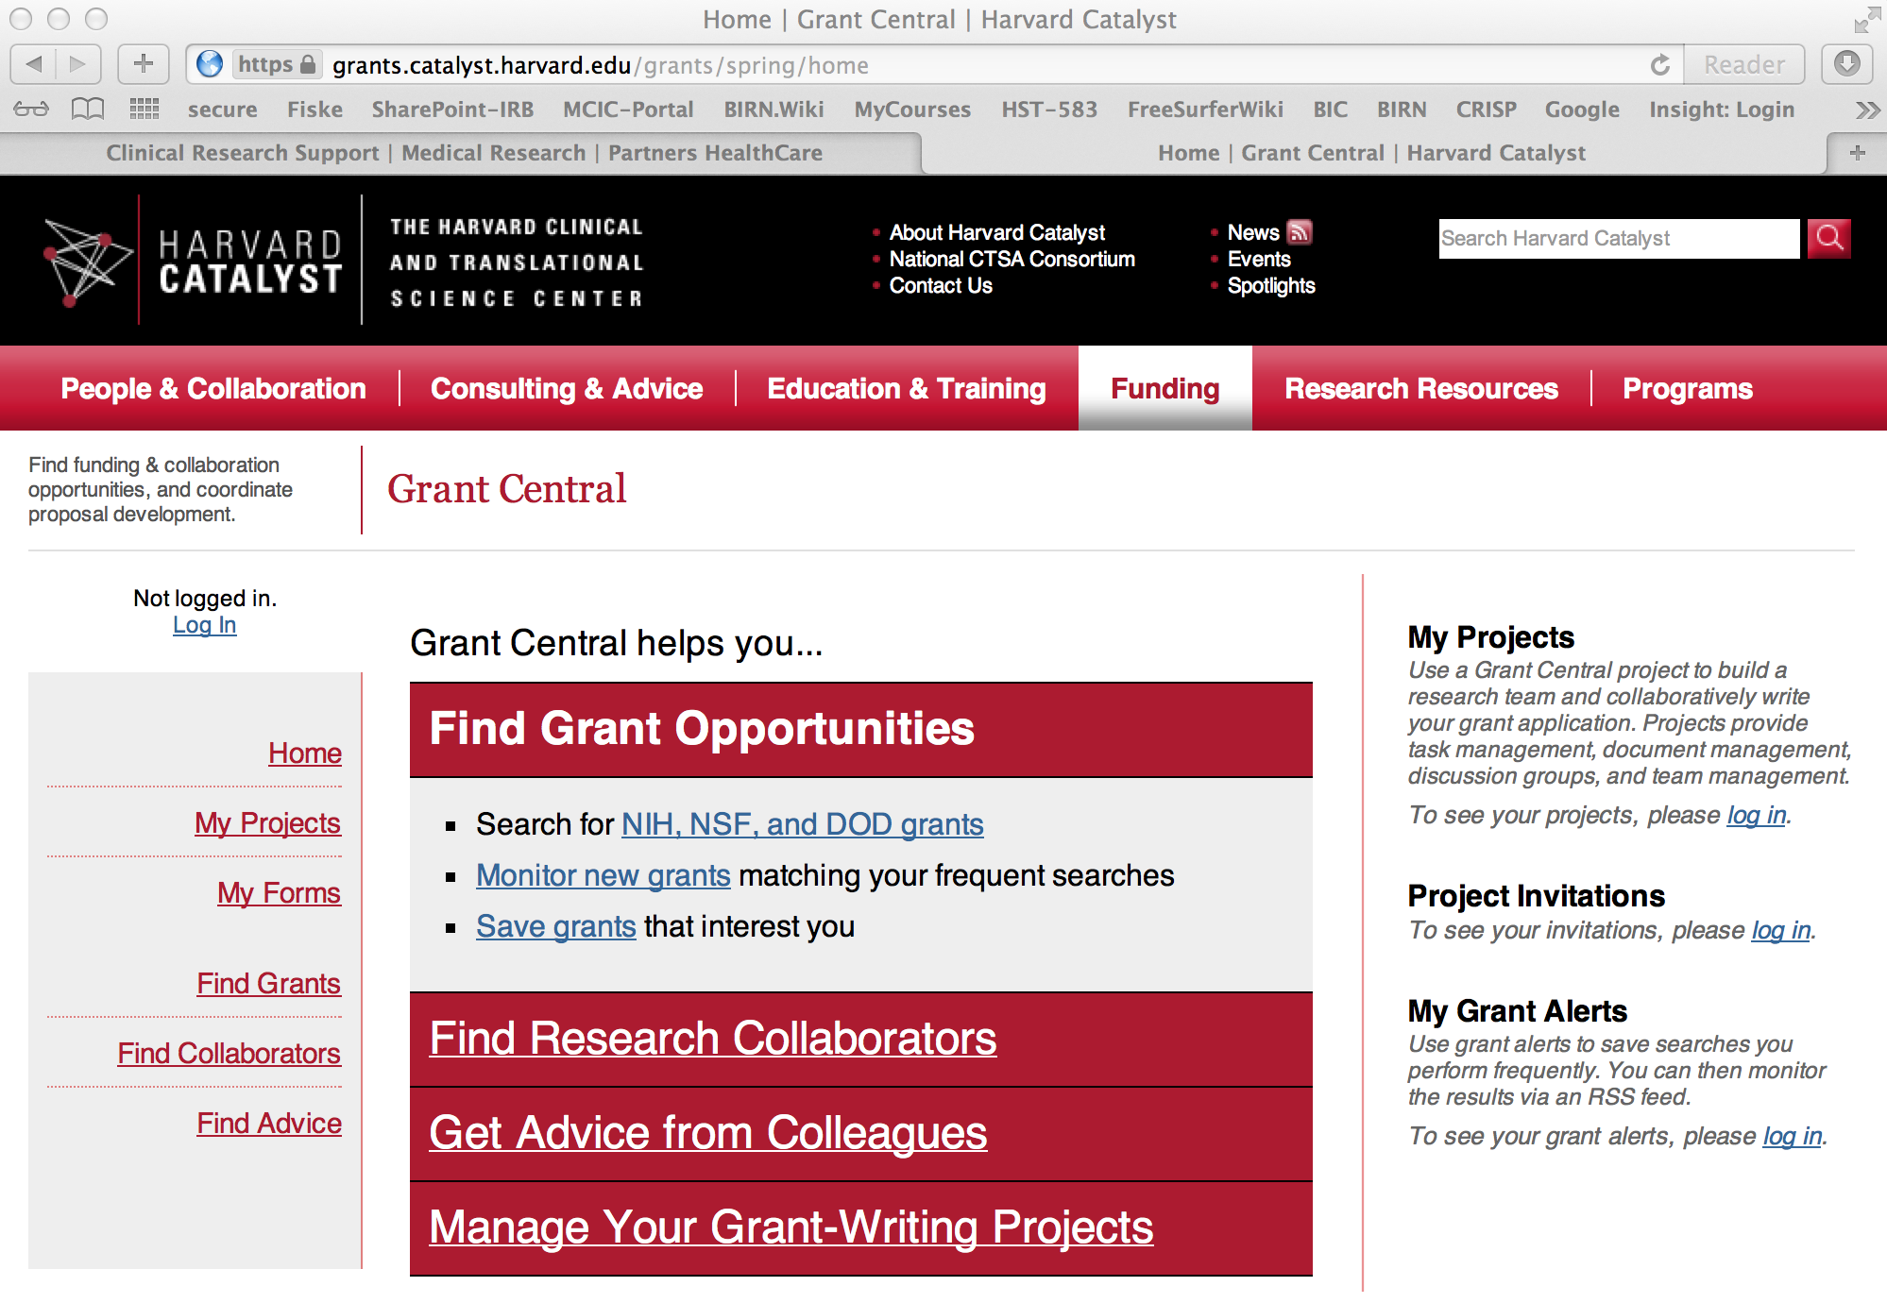
Harvard Catalyst Search Results

Slide 17
https://ecor.mgh.harvard.edu/

Slide 19
NIH grants
https://grants.nih.gov/funding/searchguide/index.html#/

Slide 20
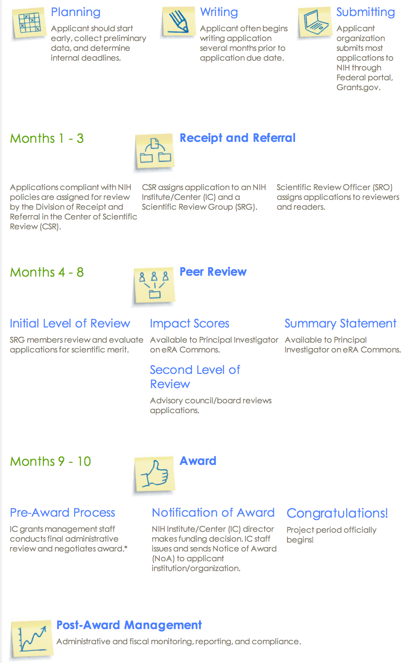
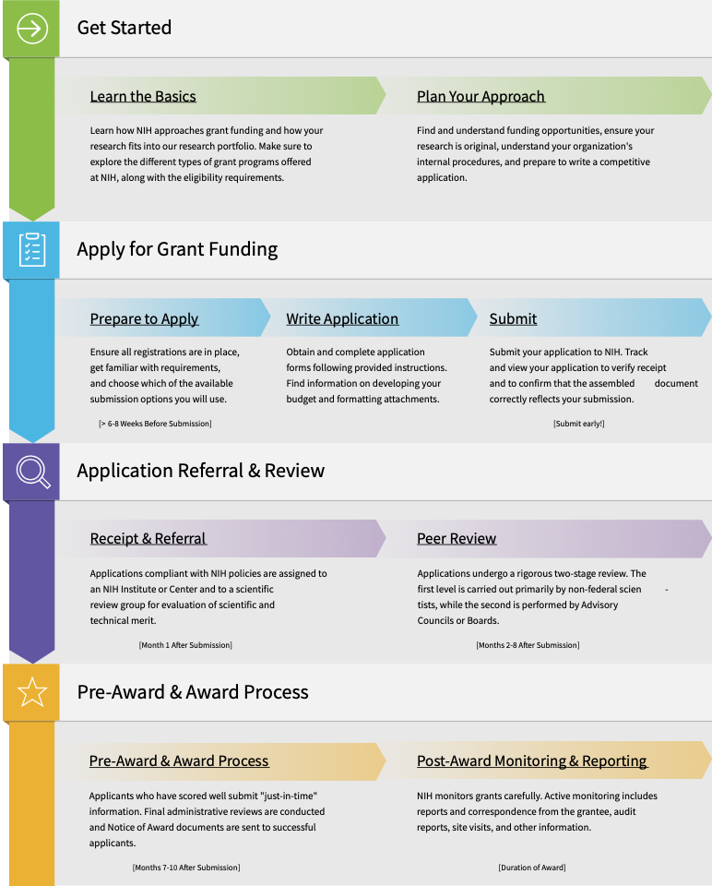
NIH Grants Process Overview
http://grants.nih.gov/grants/grants_process.htm

Slide 21
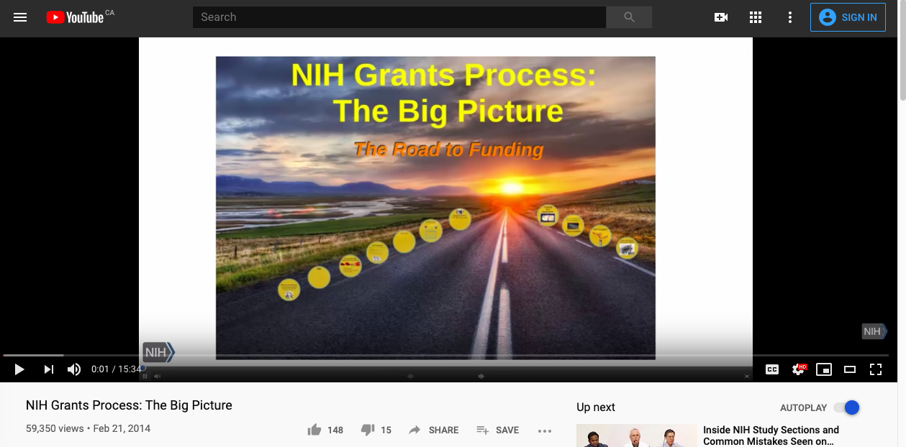
NIH Grants Process Overview
https://www.youtube.com/watch?v=rNwsg_PR90w

Slide 22
NIH Grants
http://grants.nih.gov
NIH made up of 27 institutes and centers
Funding for a particular grant comes from one or more of these centers
http://www.nih.gov/icd/
The NIH classifies grants by activity code
Each activity code has different requirements and restrictions
To search for grant codes:
http://grants.nih.gov/grants/funding/funding_program.htm
For a detailed activity code listing: http://grants.nih.gov/grants/funding/ac_search_results.htm
Search currently funded grants with the NIH Reporter
http://projectreporter.nih.gov/reporter.cfm

Slide 23
NIH Institutes
Each institute has different people on staff and different internal politics
It’s a good idea to get to know the institute, its politics and its people and
Get the people there to know you too.
In your letter of intent/cover letter, direct your grant to 1-2 specific institutes for funding.
This benefits you and NIH
The NIH staff will not need to figure out where to send your grant, and you are more likely to have your grant sent to the right places.
Each institute has its own budget for funding grants.

Slide 24
Select Activity Codes Summary
F32: NIH Training Grant (Individual Postdoctoral Fellowship)
Pays only post-doc salary; (does not cover research costs)
Judged on the merit of the post-doc applying & quality of mentor’s data
T32: Institutional Research Training Grant
An award given to an institution to fund postdoctoral research
Post-docs would apply for these through their institution, not through the NIH
K awards support the transition to an independent investigator
Different K awards for different types of people: Some are for MD, others for PhDs. Some are for clinical research and others for basic science.
Each type of K award has its own rules.
K awards judge (1) the applicant’s potential to become a good scientist, (2) the plan for research & education conducted during the grant period, and (3)the mentor(s)
Most K awards require you be a US citizen, or hold a faculty-track position
K99/R00: The only K award available to non-US citizen post-docs
R21 vs R01: Depends on the project and the outlook of the review committee
R21: 2 years of funding, for smaller exploratory projects, require less money than R01s, require less preliminary data, must hold feasibility
R01: Major projects, must have a high chance of success

Slide 25
RFA vs PA vs FOA
Request for Application (RFA):
Invitations for applications in well-defined scientific area, to accomplish specific program objectives
Score threshold for RFA funding may be lower
RFA list:
http://grants.nih.gov/grants/guide/search_results.htm?year=active&scope=rfa
Program Announcement (PA):
Identifies areas of increased priority &/or emphasis on particular funding mechanisms for a specific area of science
http://grants.nih.gov/grants/guide/search_results.htm?year=active&scope=pa
Funding Opportunity Announcement (FOA) or Parent Announcement:
A Parent Announcement encompasses applications that do not fit into either of the above categories
NIH and other HHS Agencies have developed omnibus Parent Announcements for use by applicants who wish to submit what were formerly termed “unsolicited” applications
http://grants.nih.gov/grants/guide/parent_announcements.htm

Slide 26
https://report.nih.gov/

Slide 27
NIH Reporter Search Page
Search Term(s)

Slide 28
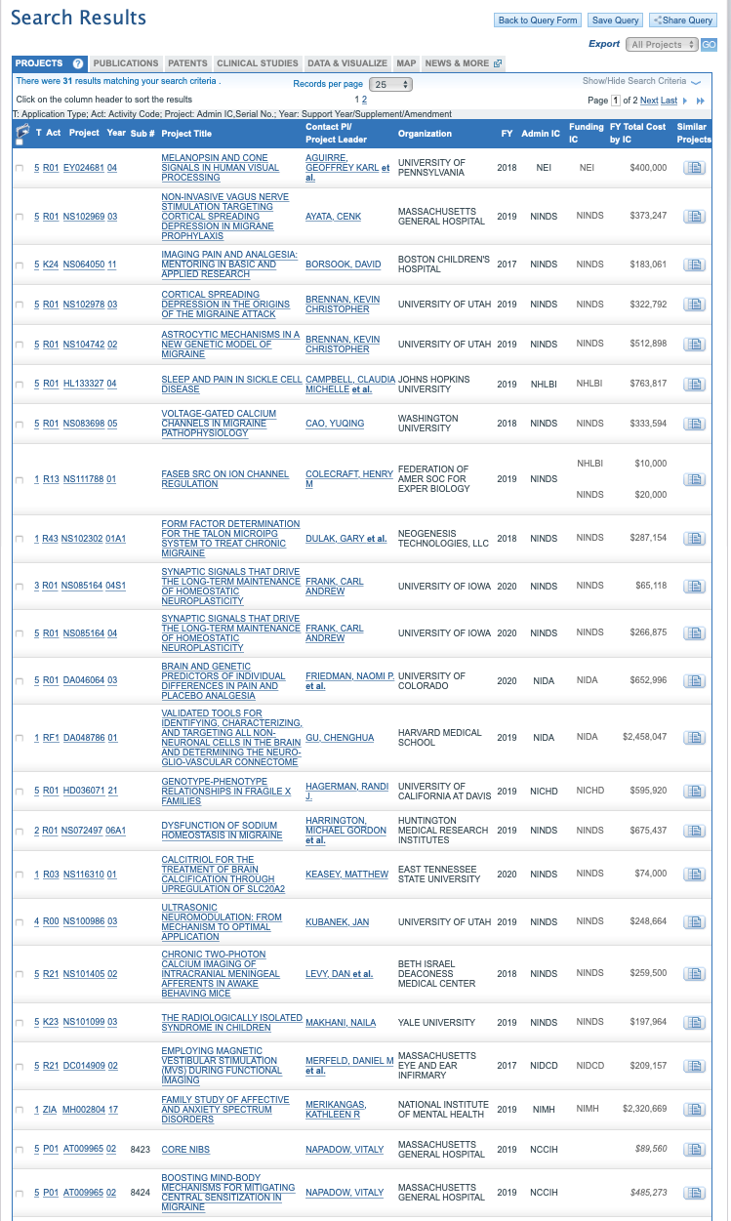
NIH Reporter Results Page “migraine headache, human, imaging”

Slide 29
Know the Rules
Always read the rules:
Once you have selected an award mechanism, read the RFA, PA or FOA thoroughly.
Announcements include:
General information common across most announcements
Unique and important information spread throughout the announcement
Eligibility information, important dates, how long the funding period is, and budget requirements
Search for current funding announcements:
http://grants.nih.gov/grants/guide/index.html

Slide 30
SROs and POs
Scientific Review Officer (SRO):
Manages your grant application through the review process
Program Officer (PO):
Manages funded grants
Before submitting a grant application, talk to the SROs & POs
Questions about whether or not a project is fundable, and worth submitting, are best left to your mentors.
SROs and POs can help you determine if a project is applicable to their funding agency and/or the most appropriate study section for your application
You can contact several different POs and SROs from different institutes. Some people will be more helpful than others. However, the staff at NIH is small and there are a limited number of people to speak with.
It is the job of SROs and POs to help you. Feel free to contact them about most questions you may have.
Many SROs and POs are helpful and want you to succeed. You can develop a long-lasting working relationship with them. It is best to be friendly and nice when speaking with the SROs and POs.

Slide 31
More stuff
SROs and POs sit in on the review process.
They can help clarify some of the issues raised by the review panel.
When you have chosen an RFA or PA, check the funding announcement to get a list of contacts
NIH institutes will often set up booths at many national meetings and hold grant-writing workshops

Slide 32
NIH Peer Review Process: Study Sections
Center for Scientific Review (CSR):
https://public.csr.nih.gov/
Organizes peer review groups & study sections to evaluate grants
Once submitted to NIH, grants are assigned to a study section
Study sections are made up of individuals with expertise in a particular field/scientific domain
Standing study section:
Review most investigator-initiated applications (both permanent and temporary members)
Special emphasis panel:
Review applications on specific topics (only temporary members)
Request a particular study section if the roster includes people with pertinent expertise
If a study section does not contain appropriate expertise to review your application, you can work with the SRO to request and recommend an additional reviewer

Slide 33
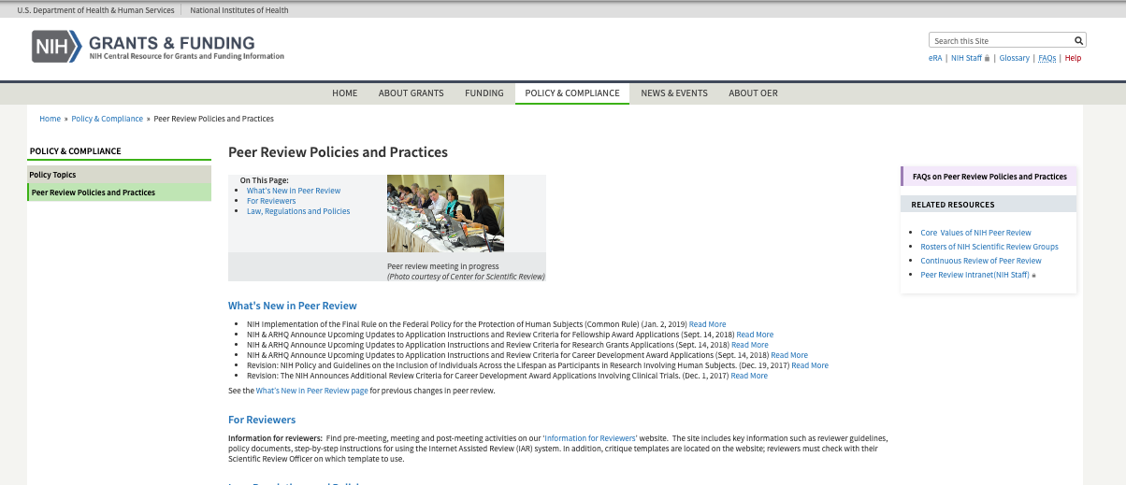
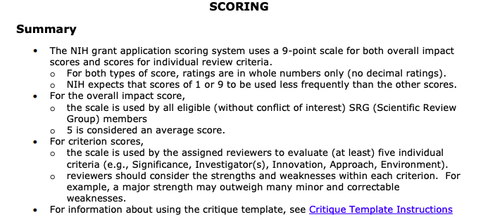
NIH Grant Scoring
Peer review at NIH:
http://grants.nih.gov/grants/peer/peer.htm
Scoring:
http://grants.nih.gov/grants/peer/guidelines_general/scoring_system_and_procedure.pdf

Slide 34
Step 3: Write the Grant
Another lecture for another day …
…. Go to Harvard Catalyst site in slide #10

Slide 35
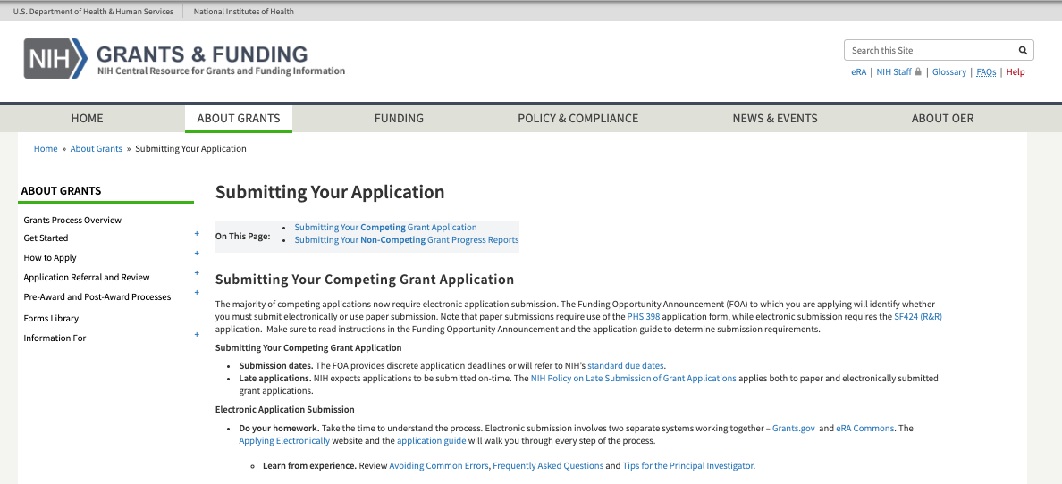
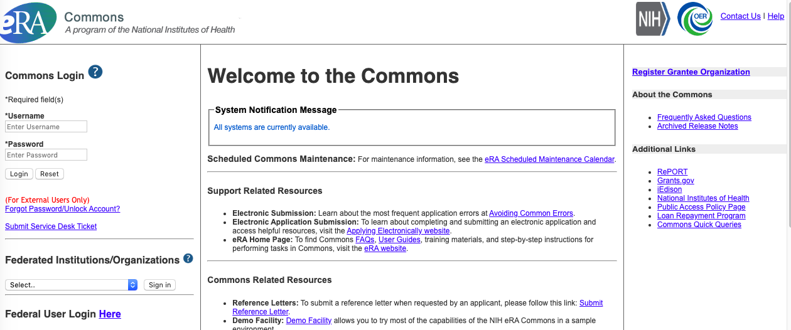
Grant Applications & Forms
NIH:
Most competing grant applications to the NIH require electronic submission.
http://grants.nih.gov/grants/submitapplication.htm
Organizations (MGH, BWH, etc.):
submit applications via www.grants.gov
online portal, to all Federal agencies
Applicants (PIs):
follow application through eRA Commons; NIH’s electronic system for grants administration.
https://commons.era.nih.gov/commons/
eRA Commons also tracks funded grants

Slide 36
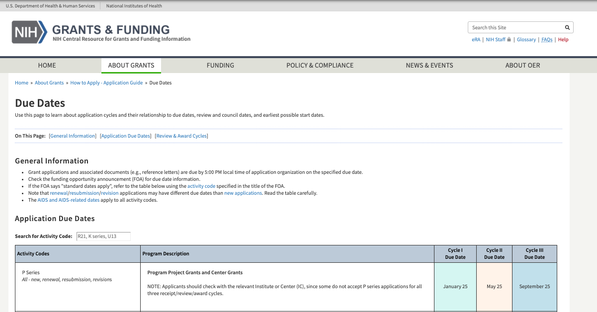
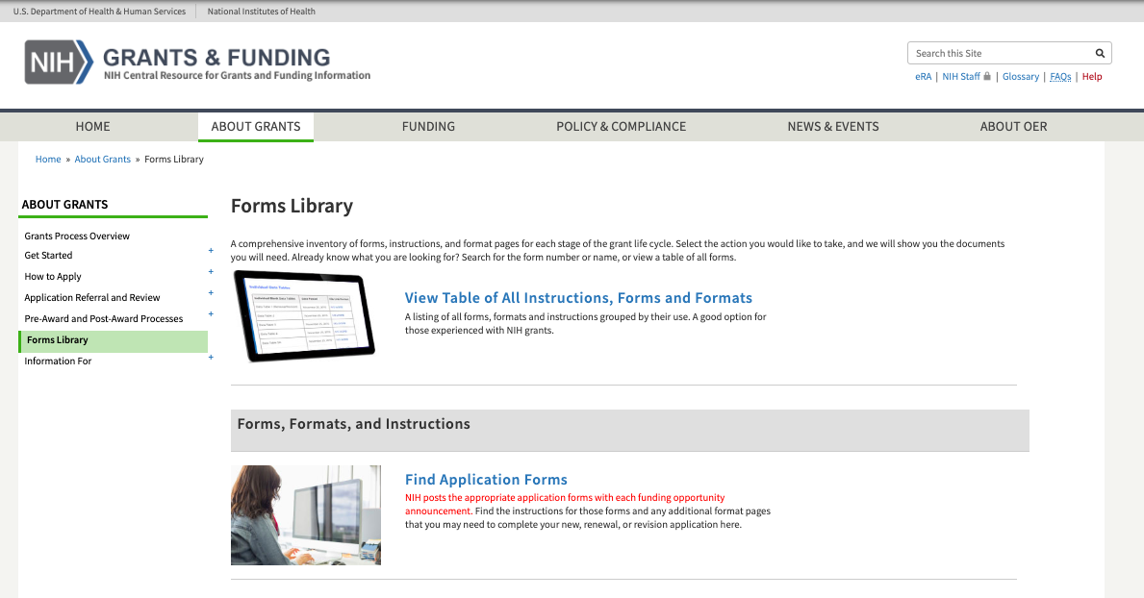
Submitting an NIH Proposal:
Check the grant announcement:
for specifics regarding dates and deadlines
NIH Deadlines:
http://grants1.nih.gov/grants/funding/submissionschedule.htm
Register early for grants.gov and eRA Commons!
*Submit early!
Always download new forms/templates for each grant submission as forms change often
http://grants.nih.gov/grants/forms.htm
*If asking for letters of recommendation or support, do so early

Slide 37
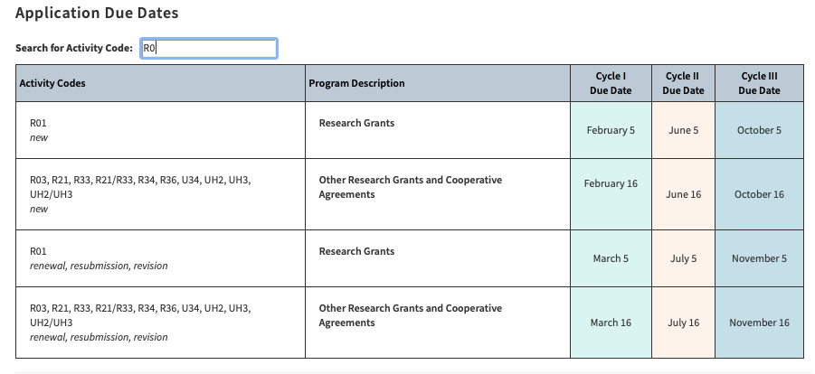
Timeline of NIH Grants
Application timeline: It’s all about the cycle
https://grants.nih.gov/grants/how-to-apply-application-guide/due-dates-and-submission-policies/due-dates.htm

Slide 38
Submitting A Partners Proposal
Partners requires internal review of all NIH grants before NIH Submission.
All proposals will be developed, submitted, and tracked online using InfoED

Slide 40
Letter of Intent/Cover Letter
Some grant announcements request a letter of intent, whereas others do not
A formal letter of intent or cover letter includes:
Funding announcement you are replying to
Institutes you would like to send your application to and
Review panels you think would be most appropriate for your project
Sending your grant to the right place can also increase your success in the review process
You may consider calling ahead to the SRO to let them know you are submitting a grant application

Slide 41
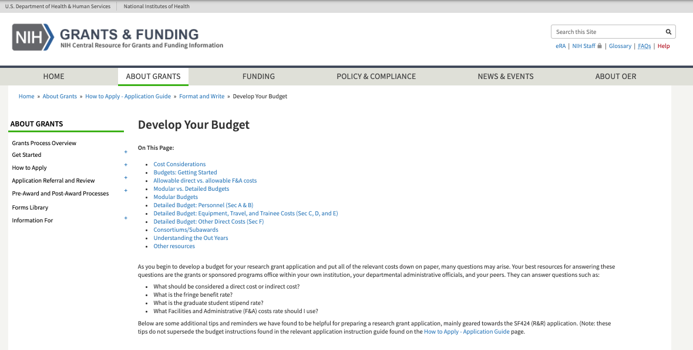
Preparing your Budget
Check the rules of the grant announcement to find budget restrictions.
This includes the budget limits and whether a modular budget is allowed
Use InfoED (where available) or the budget template on the Partners Research Management website.
Request the appropriate amount of money to conduct your research properly and honestly.
This includes a consideration of cohort size, outcome measures, and power.
http://grants.nih.gov/grants/developing_budget.htm

Slide 42
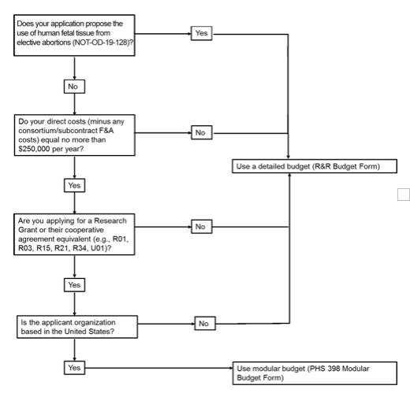
Budgets: Modular vs Detailed
Modular budget:
Lump sums of $25,000 intervals
Must include: personal justification, consortium justification (where applicable), additional narrative justification
Detailed budget:
Includes: personnel, equipment, travel, trainees, materials and supplies, animals, publications, consultants, computer, alterations, patient care, tuition, and other costs
https://grants.nih.gov/grants/how-to-apply-application-guide/format-and-write/develop-your-budget.htm

Slide 43
More on Budget
Having a budget planned out is essential to conduct honest research
A full budget is required for Just-In-Time (JIT) submissions, which will be requested if your project receives a good score at review and is likely to be funded
For some categories (ex. office supplies) it is fine to estimate
Get help from the grants or sponsored programs office within your own institution, your departmental administrative officials, and your peers
Things to take into consideration:
Indirect (F&A) vs. direct costs
Salaries
Fringe benefit rates
Departmental fees
IT support (Martinos &/or your parent institution)

Slide 44
Use the Partners Template

Slide 45
Indirect Costs (F&A)
Remember to consider indirect rates in your budget
Strict 15% Minimum IDC Policy for ALL grants, only exceptions are for certain training fellowships*
Each Partners entity negotiates a multi-year agreement of predetermined F&A rates with DHHS every 3-4 years
Partners charges indirects on all grants
Indirects are used to fund institutional resources
Current Partners Institutional Agreements found on Navigator
Current MGH On Site Indirect rate = 68% (FY2020)
Complex, read the full policy
*See guidance on Research Navigator

Slide 46
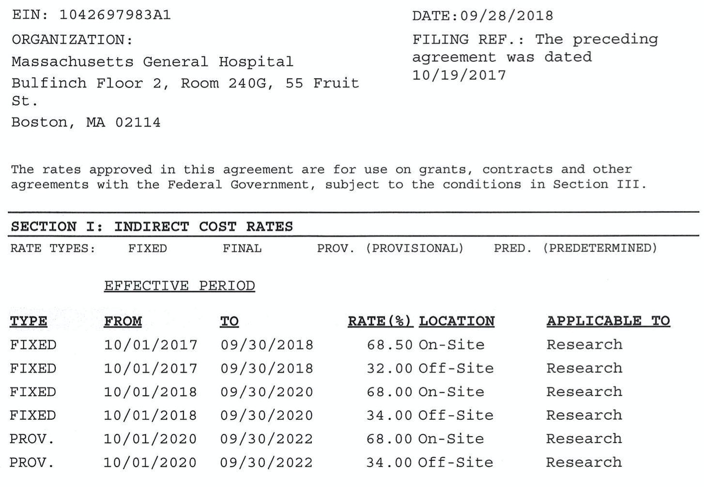
Indirect Costs (F&A)

Slide 47
Salaries & Percent Effort
Salary ranges are dependent on official title and years of experience
Discuss your salary with your mentor
Raises can be requested at the departmental level upon success with grant submissions
Special permission is required for raises >6%
The Center for Faculty Development provides consultation on professional staff compensation at Partners
Maximum Percent Effort allowed is 100% / 12 Calendar Months
In the “overlap” section of your Other Support page, it should explain how percent effort will be changed to maintain no more than 100%
Special approval is needed for changes to percent effort of 25% or more for Key Personnel
Work with your grant administrator to adjust your support

Slide 48
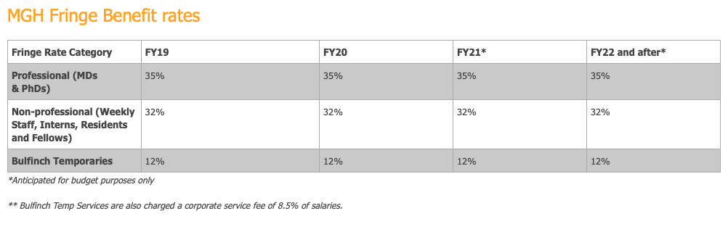
Fringe Benefit Rates
Fringe Benefit Rates:
Approved by federal government for each fiscal year
Cover cost of insurance coverage, retirement, etc.
Fiscal year begins October 1st

Slide 49
Departmental Fees
Department fees:
Ex. Martinos Center IT support, research core fees

Slide 50
How Long Will It Take?
Expect to spend 2+ months of hard work to prepare your first NIH type grant
It can take 5-18 months after receipt for an award to be made, up to 28 months if you need to resubmit

Slide 51
What if I don’t get funded?
Join the crowd! You are not alone.
Resubmissions
You are allowed 1 resubmission of an NIH application – if scored, comments can be useful
Then… Try again, and keep trying!

Slide 52
Questions?
READ THE MATERIAL ON THE LINKS PROVIDED!!!!!
Still got questions:
rgollub@partners.org
DISCLAIMER: All information was verified to be current 02/27/2020. But things change so, if you find any errors, broken links, or salient updates, please send them to me and I will update and repost these slides.

