Slide 1
Introduction to MATLAB
Melissa Haskell
Notes:
tip: lmstat for toolboxes

Slide 2
Thank you to Aapo Nnummenmaa!
Notes:
Thank you to Aapo. This year I’ve added some interactive questions and examples.

Slide 3
Background

Slide 4
Overview
What is MATLAB?
MATLAB=(MATrix LABoratory)
Mathematical scripting language.
Scientific computation tool.
Scientific visualization tool.
Your best friend!
What can I do with MATLAB?
Automate complex data processing streams.
Utilize a vast library of “toolboxes” for various tasks.
Write your own data analysis/computation tools.
You can do almost ANYTHING (except make coffee…)

Slide 5
Double-edged sword
Pros of MATLAB
MATLAB is a commercial package:
Support is available and programs should “work”.
MATLAB is a “scripting language”:
Programs don’t need to be “compiled”.
Allows “on-line debugging” and fast testing of ideas.
Cons of MATLAB
MATLAB is a commercial package:
All toolboxes cost money (a LOT for non-academics).
MATLAB is a “scripting language”:
Variables can be declared without explicit types.
MATLAB tries to guess what you mean (BEWARE! – examples to come)
Notes:
”i” as imaginary number vs looping variable.

Slide 6
Alternatives to MATLAB
GNU Octave
Free, intended to be fully compatible with MATLAB
https://gnu.org/software/octave/
Scilab
Open source, code translator for MATLAB -> Scilab.
http://www.scilab.org
Python
Free, generic scripting language
NumPy, SciPy, & Matplotlib extensions mimic MATLAB.
Learn as many as you see fit!
Use the one(s) that make YOUR workflow EFFICIENT.

Slide 7
Getting Started

Slide 8
Opening MATLAB
If you are logged into a Linux box in Martinos Center
Command matlab opens DEFAULT MATLAB version (or matlab&)
Note: This is NOT necessarily the LATEST version
Other versions can be found as well:
/usr/pubsw/common/matlab/R2016a/bin/matlabOpens the version 7.5 should you happen to need that.

Slide 9
MATLAB Interface & First Examples

Slide 10
Help!
Remember: MATLAB is your best friend!
In many case, the documentation texts are quite informative and educational.
You even get help to using command help:
By typing helpdesk (or doc) into the MATLAB command line, an interactive help system launched.
You can start browsing and searching for various things.
mathworks.com

Slide 11
MATLAB syntax
create vector -> x = 1:step_size:10; (default step size is one)
create row vector -> x = [1, 2, 3];
create column vector -> x = [1; 2; 3];
don’t need commas, but it will suppress output to the command line
Notes:
size vs. numel

Slide 12
Some ubiquitous MATLAB commands
size:
Tells you the size of a variable (by each index).
zeros:
You can create a matrix filled with zeros.
Useful for allocating memory.
.(*, /, …) element-by-element operations:
X.*Y multiplies elements of
equal-sized arrays.
repmat:
Create a replicate of array:
Notes:
size vs. numel

Slide 13
Notes:
What is the output of size( [1 2 3; 4 5 6] )?
https://www.polleverywhere.com/multiple_choice_polls/BlciIEIKl56yZA0

Slide 14
Notes:
Which of the following will produce a vector [1, 2, 4, 16]?
https://www.polleverywhere.com/multiple_choice_polls/dA5WgghoT0RwmoW

Slide 15
Scripts, Functions & The Editor

Slide 16
Writing and executing a script
Typing the commands to the prompt is not very convenient in the long run.
It is better to write a script that executes all commands.
Example

Slide 17
Writing a function
If you use a particular piece of code often, it is better to write it as a separate function.
The output argument(s) are in brackets [ ].
The input argument(s) are in parentheses ( ).
The file begins with “function”.
The file ends with “end”.
The name of the function and file should be the same!
Save this as m-file: compute_square.m
-> Example

Slide 18
The MATLAB editor: Quite convenient!
To run piece of code: Highlight it & press F9:
Extremely useful for “interactive debugging”.
The Editor also gives you useful “warnings” and even “programming tips”!
Debugger demo!!

Slide 19
“Advanced” uses of the MATLAB editor
Use “cell mode” to move between blocks of script.
Inserting into the beginning of a line creates a cell.
You can evaluate the whole cell and jump to next.
You can turn the cell mode on/off from the Editor top panel.
%%

Slide 20
“Advanced” uses of the MATLAB editor (cont.)
Use “code folding” toggle hiding parts of script.
MATLAB editor can fold pieces of code under command blocks.
File -> Preferences… -> Editor / Debugger -> Code Folding
You can create “fake logical tests” like to:
1) determine if a piece script is evaluated of not (change 0 -> 1).
2) To hide the piece of script.
if 1 = = 0

Slide 21
Visualization tools

Slide 22
Plotting 3D points
The command plot3 allows you to plot points in 3-dimensional space.
Basic usage: plot3(X,Y,Z)
X/Y/Z is a vector of x/y/z-coordinates of all points.

Slide 23
Visualizing 2D/3D vector fields
Vector plot
Streamline plot
quiver / quiver3
streamline / streamslice

Slide 24
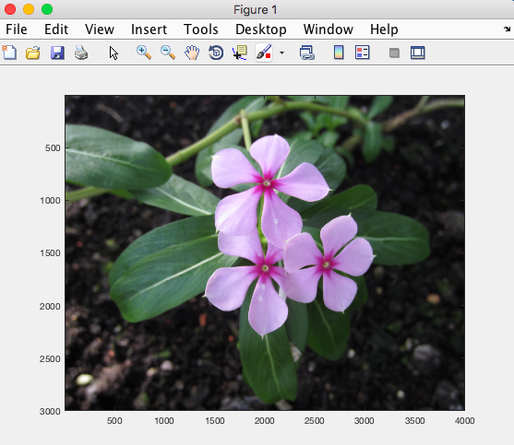
Visualizing image data / matrices

Slide 25
Surface rendering with MATLAB
Discrete surface consists of “vertex points” and “edges”:
Surface or “Patch” objects utilize such triangulation.
In MATLAB, you need two lists of numbers:
“Vertices” are the coordinates of surface points.
“Faces” tell which three vertices form a given triangle.

Slide 26
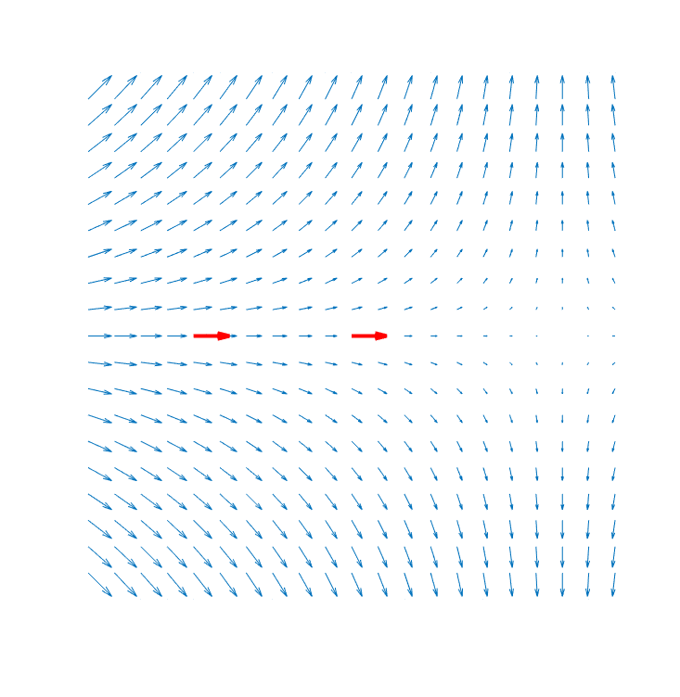
Time Vary Figure Example: Magnetic Particle Imaging
v(t)
v(t)
Rx
coil
Notes:
If I have time – filter out f0

Slide 27
Your imagination is the limit!
The following have been all made using MATLAB
tools presented (cosmetic enhancement in
Illustrator).

Slide 28
Miscellaneous “advanced” topics

Slide 29
Parallel computing toolbox
MATLAB loops can be slow.
You should try to use vector operations when possible!
Example scenario: you have to run an intensive simulation for a grant due in a week.
Said simulation takes two weeks due to a massive FOR-loop.
Loops are “independent” -> you can parallelize the loop.
Results cannot depend on the order of loop iterations!
NOTE: uses multiple MATLAB instances
Make sure to terminate the jobs when done.
It also uses the parallel computation TOOLBOX license!

Slide 30
Using parallel for-loop (PARFOR)
Homework: compare the elapsed time when using FOR-loop!

Slide 31
Custom Optimization in MATLAB
Given a range of capacitors that can be connected in series, how can I create the desired final capacitance?
Desired capacitance: 6.95 µF
Capacitors in the lab: [1.4, 5, 4, 6.3, 8.5, 3, 10, 0]*1e-6;
What values of $x_{1},x_{2},…$ will give me the $C_{T}$ that I want?
$$\frac{1}{C_{T}}=\frac{x_{1}}{C_{1}}+\frac{x_{2}}{C_{2}}+…$$

Slide 32
Custom Optimization in MATLAB
What values of $x_{1},x_{2},…$ will give me the $C_{T}$ that I want?
$$\frac{1}{C_{T}}=\frac{x_{1}}{C_{1}}+\frac{x_{2}}{C_{2}}+…$$
Iteratively change values of x to find the optimal one:
$$[ \hat{x} ]={argmin_{x}\left\|C_{desired}−C_{T}(x)\right\|}_{}$$
$\left\|\vec{v}\right\|=\sqrt{v_{1}^{2}+v_{2}^{2}+⋯v_{n}^{2}}$

Slide 33
Custom Optimization in MATLAB
$$[ \hat{x} ]={argmin_{x}\left\|C_{desired}−C_{T}(x)\right\|}_{}$$
objective function
”It is our objective to make this function as small as possible!!!”
Can write custom objection function in MATLAB, and then have it handle the minimization
- lots of different options for how to do the minimization

Slide 34
Writing a function
If you use a particular piece of code often, it is better to write it as a separate function.
The output argument(s) are in brackets [ ].
The input argument(s) are in parentheses ( ).
The file begins with “function”.
The file ends with “end”.

Slide 35
Custom Optimization in MATLAB: Example
CZ Cooley et. al, 2017

Slide 36
Running MATLAB scripts from SHELL
The MATLAB Editor is nice but:
Let us assume that you have a complicated SHELL processing stream using FSL & FreeSurfer tools.
You want to do a little bit of something in the middle with MATLAB that neither FSL or FS can do.
Then it is more convenient to run your MATLAB script from UNIX command line.
matlab.new -nodesktop -nodisplay -r "run /full/path/to/script/my_script”
NOTE:
NO *.m extension in the script file name
Make sure last line of the file my_script.m is: exit;

Slide 37
Running MATLAB scripts from SHELL (Cont)
What if I need to pass variables to the MATLAB script?
Convenient way is to use SHELL environment variables.
MATLAB has command getenv (and setenv) to do this.

Slide 38
Executing UNIX commands from MATLAB
What if the scenario is the opposite:
I need an FSL command in the middle of an elaborate MATLAB processing pipeline.
MATLAB has a command unix to do just this.
If the variable res=0 there were no errors.
Of course you should always
CHECK the result!
b0
b0_brain

Slide 39
Martinos Center MATLAB information

Slide 40
MATLAB packages & licenses
Martinos Center has a number of MATLAB licenses and various toolboxes available.
These can be viewed using SHELL command lmstat –a
Different toolboxes have different numbers of licenses.
FreeSurfer has a MATLAB “toolbox”
/usr/local/freesurfer/stable5_3_0/matlab
Contains functions for reading FS surfaces, NIFTI MRI volumes etc.
Various other packages with MATLAB tools:
MNE for MEG/EEG source analysis
/usr/pubsw/packages/mne/stable/share/matlab/
SPM for fMRI etc (/usr/pubsw/common/spm)

Slide 41
Setting MATLAB startup settings: startup.m
The recommended way to add the paths to tools that you ALWAYS use is to manually edit the file startup.m
The default Martinos Center location is:
~username/matlab/startup.m
If you need to locate where that file is use MATLAB command which:
For example, if you want SPM8 to be automatically available you would write this to your startup.m:
Then command spm will launch the SPM8 GUI in MATLAB.

Slide 42
Some further notes on paths in MATLAB
It is recommended that you DO NOT USE command pathdef OR the GUI Set Path for adding paths.
The recommended way to add path to tools that you only need in a specific script is to:
Use command addpath (see, previously presented slide “Calling a function inside a script”).
In case you need to add all subdirectories you can use addpath in conjunction with genpath:
addpath(genpath(’~username/matlab/my_tools_folder'))

Slide 43
MATLAB & launchpad
You can run MATLAB jobs in the cluster (launchpad):
http://www.nmr.mgh.harvard.edu/martinos/userInfo/computer/launchpad.php
You can find detailed instructions under “How can I run a MATLAB job” section in the above link.
There is a separate MATLAB queue in launchpad.
Max of 20 jobs for a given user.
Only 1 job that uses any toolbox.
Running 100 MATLAB jobs in launchpad take 100 licenses.
It is recommended that you create a stand-alone version of your MATLAB program in order to avoid license failure.

Slide 44
Accessing MATLAB from your fully encrypted and sanitized “home” laptop
What if I need to do some MATLAB stuff on my laptop?
You can install MATLAB with network license:
https://www.nmr.mgh.harvard.edu/martinos/userInfo/computer/matlab/
You can utilize remote access to your work desktop:
https://www.martinos.org/intranet/computer/remote-access
Convenient if you need to check if a script is running correctly (instead of waiting 12 hours to see it crashed).
If you need MATLAB anytime/anywhere, then you need to purchase a standalone license.

Slide 45
Thanks for listening!
Questions?
Feedback: mhaskell@fas.harvard.edu

Slide 46
Code Snippets from demos

Slide 47
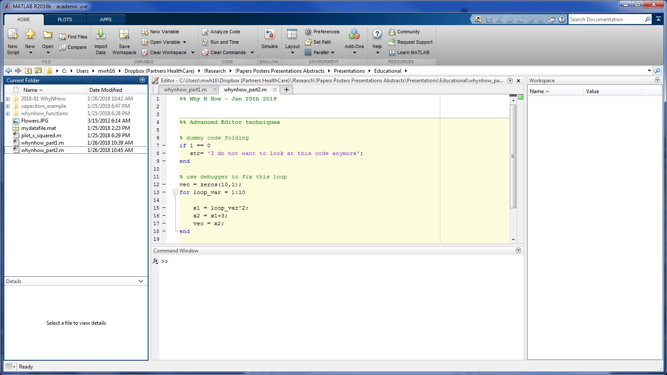
MATLAB Interface – point out different parts

Slide 48
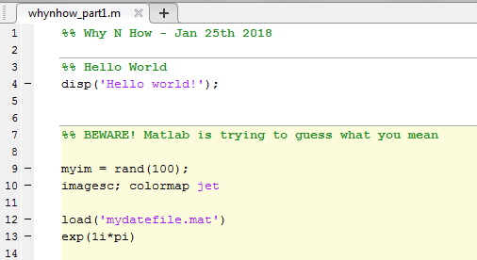
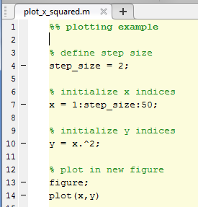
First Examples – type this code on command line

Slide 49
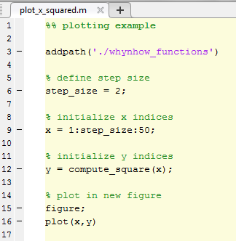
Using Editor and Functions
show editor, then write function

Slide 50
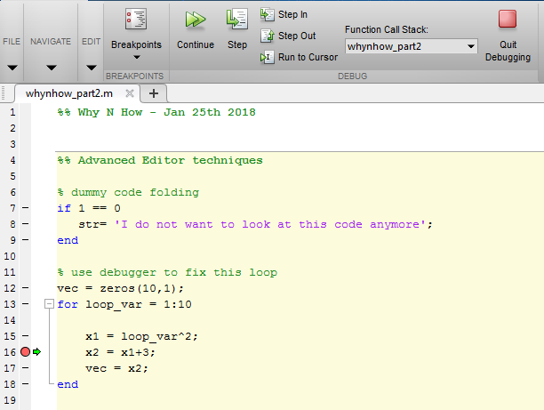
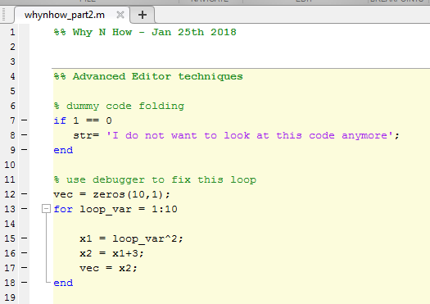
Other Editor Techniques – code folding and debugging
use debugger, set conditional breakpoint

Slide 51
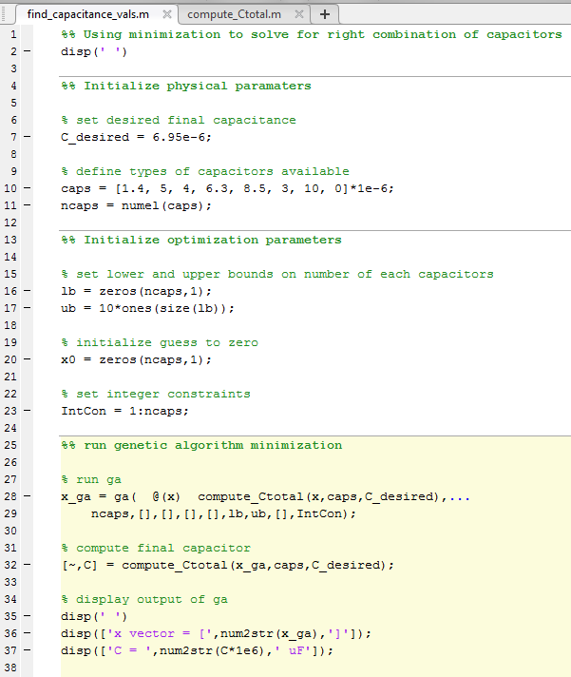
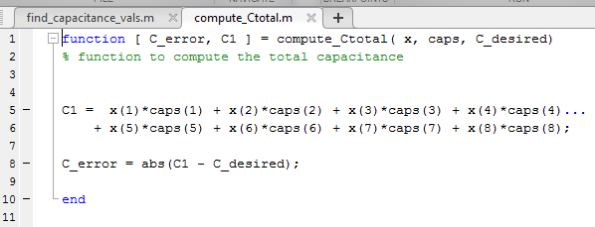
Optimization Example

